Slide 1
Visual Information Retrieval
Gang Hua
Department of Computer Science
Stevens Institute of Technology
01/22/2014
Acknowledgement:
Thanks Cees Snoek for sharing his course slides!
A portion of the slides in this course is adapted from his slides.

Slide 2
CS598 Visual information Retrieval
Lecture I: Part I: Introduction to the course

Slide 3
Who am I?
华刚
Prof. Gang Hua
Associate Professor of Computer Science
Stevens Institute of Technology
Research Staff Member (07/2010—08/2011)
IBM T J. Watson Research Center
Senior Researcher (08/2009—07/2010)
Nokia Research Center Hollywood
Scientist (07/2006—08/2009)
Microsoft Live Labs Research
Ph.D. in ECE, Northwestern University, 06/2006

Slide 4
And now, who are you?
Now, who are you?
Why do you choose this class?
What do you expect to learn?
Previous experience?

Slide 5
Course promise
You will learn the theory and practice of visual information retrieval.
You will be able to recall the major scientific problems in visual information retrieval.
You will be able to understand and explain how state-of-the-art visual search systems work.

Slide 6
Course Information (1)
CS598 Visual Information Retrieval
Term: Spring 2014
Instructor: Prof. Gang Hua
Class time: Monday 6:15pm—8:40pm
Location: McLean Chemical Sciences Building 414
Office Hour: Wednesday 4:00pm—5:00pm by appointment
Office: Lieb/Room305
Course Assistant: Haoxiang Li
Course Website: http://www.cs.stevens.edu/~ghua/ghweb/Teaching/CS598Spring2014.htm

Slide 7
Course Information (2)
Text Book:
No required text book
Recommended Reading
See course website for recommended
Grading:
Class participation: 10%
One written homework: 10%
4 course project:
Project #1(10%), Project #2(10%), Project #3 (15%), Project #4 (15%)
Final Project & Presentation: (15% System demo and presentation, 15% final report)
Final grade: A-- 90% to 100%; B--80% to 89%; C-- 65% to 79%; F -- < 65% .

Slide 8
Course information (3)
Projects are all group project
You will be grouped into a team with 5-6 members
Your final project will be integrating your first four project into an end-to-end image search system
So it is important that you don’t lag behind!!
Program language is not specified, pick up your favorite one with the team!

Slide 9
Rules
Need to be absent from class?
1 point per class: please send notification and justification at least 2 days before the class
Late submission of homework?
The maximum grade you can get from your late homework decreases 50% per day
Zero tolerance on plagiarism!!
The first time you receive zero grade for the assignment
The second time you get “F” in your final grade
Refer to Stevens honor system for your behavior

Slide 10
Prerequisites
No definite pre-requisite
However, it would be helpful if you possess
Basic knowledge of computer vision, pattern recognition and information retrieval
e.g.,
CS558 Computer Vision
CS559 Machine Learning
We will learning something about information retrieval today

Slide 11
What is a visual Information retrieval?
Definition
Visual information retrieval is the activity of obtaining (i.e., search and retrieve) visual information resources relevant to an information need (i.e., a query) from a collection of visual information resources (e.g., image and video database).

Slide 12
Why needed?
Slide credit: JR Smith, IBM

Slide 13
Why bother?
> $100 million
Slide credit: C. Snoek (Univ. of Amsterdam)

Slide 14
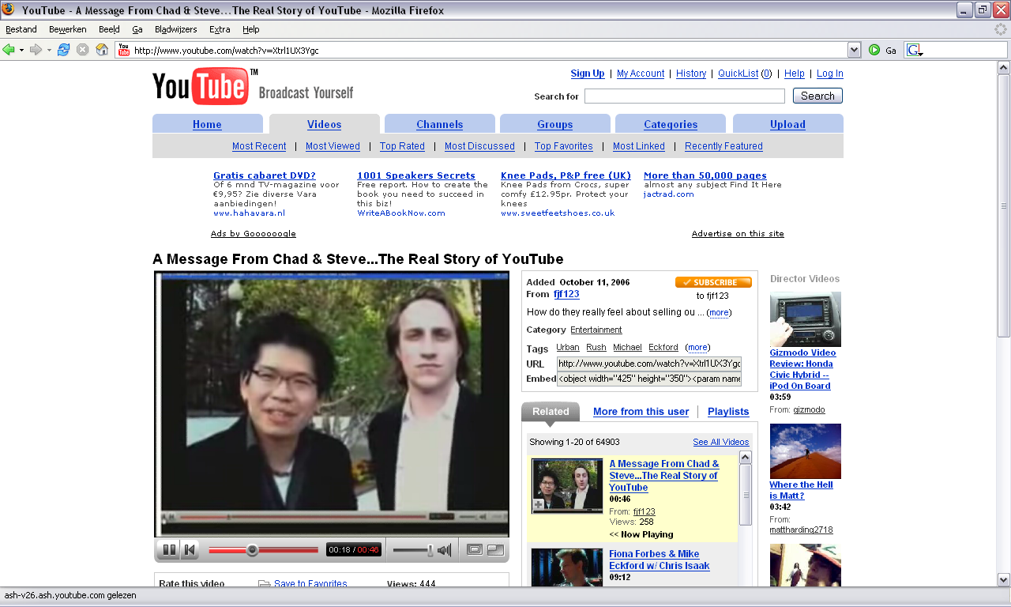
Still not convinced?
$1.65 billion
Slide credit: C. Snoek (Univ. of Amsterdam)

Slide 15
Quiz: How big is the problem?
Quiz: What is the size of this problem?
How many images uploads to Facebook?
How many uploads on YouTube per day?
What is the size of a typical national broadcast video archive?

Slide 16
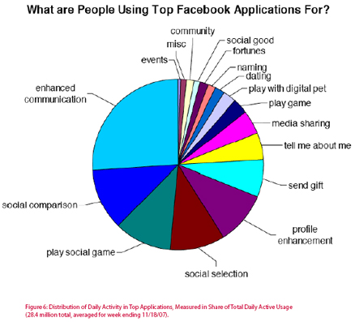
Statistics from Facebook
350 millions of photos uploaded to Facebook daily
Photo application was NO.1 utilized application for a long time since the inception of Facebook

Slide 17
Statistics from YouTube
More than 1 billion unique users visit YouTube each month
Over 6 billion hours of video are watched each month on
100 hours of video are uploaded to YouTube every minute
80% of YouTube traffic comes from outside the US
YouTube is localized in 61 countries and across 61 languages
According to Nielsen, YouTube reaches more US adults ages 18-34 than any cable network
Millions of subscriptions happen each day. The number of people subscribing daily is up more than 3x since last year, and the number of daily subscriptions is up more than 4x since last year

Slide 18
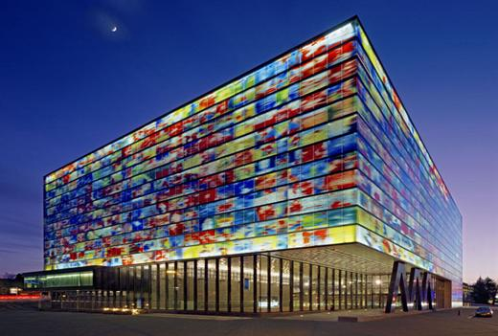
Answer from the Netherlands
Europe’s largest digitization project
Yearly ingest
15,000 hours of video
40,000 hours of radio
>1 peta-byte per year
Next 6 years
137,200 hours of video
22,510 hours of film
123,900 hours of audio
2,900,000 photo’s
Lack of metadata
Slide credit: C. Snoek (Univ. of Amsterdam)

Slide 19
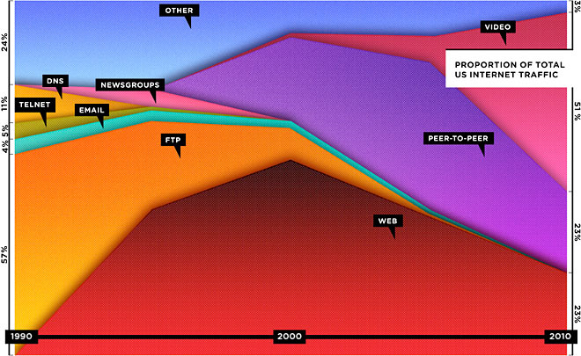
Latest update from Wired (the web is dying!)

Slide 20
visual information retrieval: Three cues
Expert-driven search
Exploit professional annotations
Crowd-driven search
Exploit what others are saying about the image
Content-driven search
Exploit the content of the images and video

Slide 21
Expert driven search
http://e-culture.multimedian.nl
Notes:
MultimediaN-GoldenVideo4

Slide 22
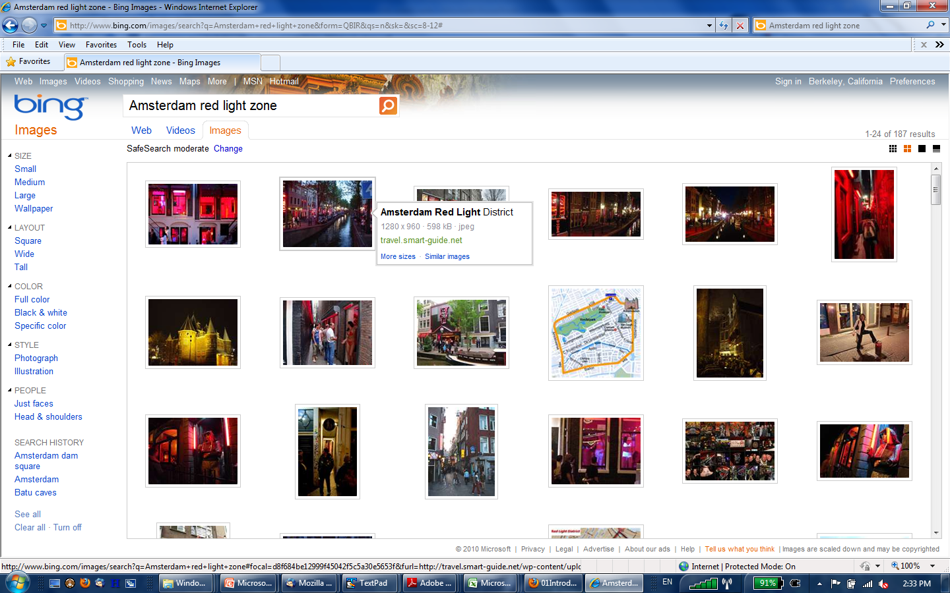
Crowd-driven search

Slide 23
Quiz: What’s the limitations of meta data based search?
Slide credit: JR Smith, IBM

Slide 24
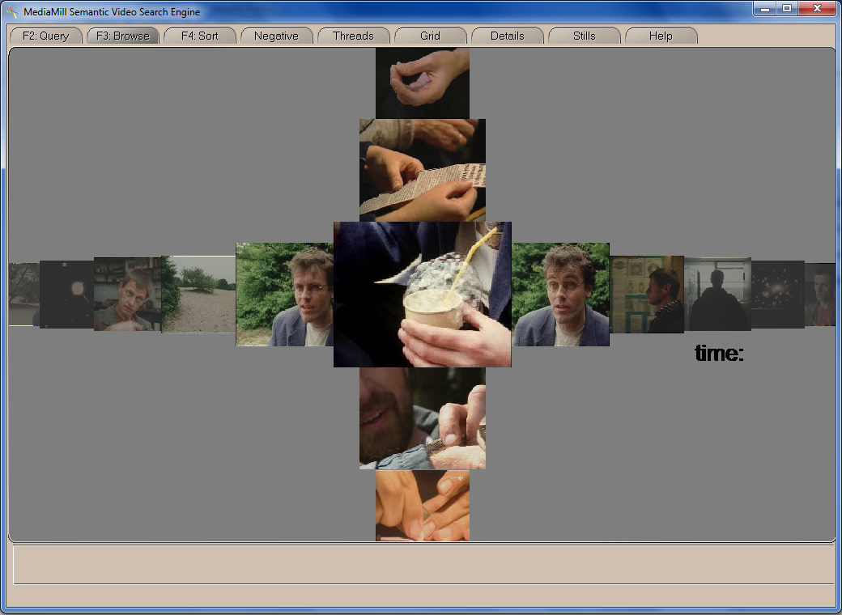
Content-driven search
http://www.mediamill.nl

Slide 25
What are the challenges?

Slide 26
Problem 1: Visual Variation
Many images of one thing, due to minor differences in
Illumination, Background, Occlusion, Viewpoint, …
This is also called the “sensory gap.”

Slide 27
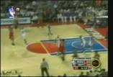
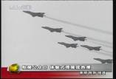
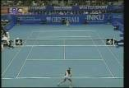
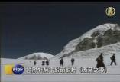
Problem 2: Visual Representation & Description
1101011011011011011011001101011011111001101011011111
1101011011011011011011001101011011111001101011011111
1101011011011011011011001101011011111001101011011111
Tree
Suit
Machine
Basketball
1101011011011011011011001101011011111001101011011111
1101011011011011011011001101011011111001101011011111
1101011011011011011011001101011011111001101011011111
US flag
Building
This is the Semantic Gap
1101011011011011011011001101011011111001101011011111
Table
1101011011011011011011001101011011111001101011011111
Aircraft
Multimedia Archives
1101011011011011011011001101011011111001101011011111
1101011011011011011011001101011011111001101011011111
Fire
1101011011011011011011001101011011111001101011011111
Humans
Dog
Tennis
Mountain
Notes:
27

Slide 28
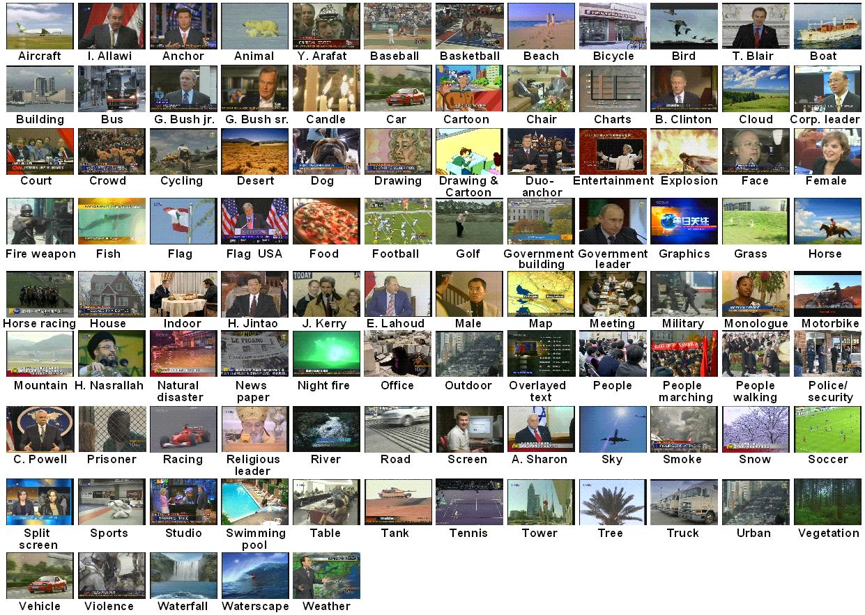
Problem 3: Many things in the world
This is the model gap.

Slide 29
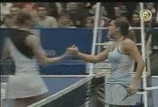
Problem 4: Query variation
Query-by-keyword
Find shots of people shaking hands
Query-by-concept
Query-by-example
Query Prediction
Query-by-humming
Query-by-gesture
This is the query-context gap
Any combination, any sequence?

Slide 30
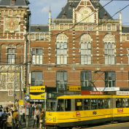
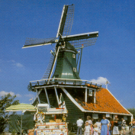
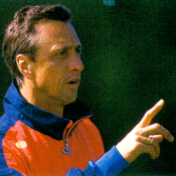
Problem 5: Use is open-ended
scope
screen
keywords
This is the interface gap

Slide 31
Summary on problems
Visual search is a diverse and challenging research topic
Sensory gap
Semanic gap
Model gap
Query-context gap
Interface gap

Slide 32
Q
A
&

Slide 33
CS598 Visual Information Retrieval
Lecture I: Part II: Basics of Information Retrieval

Slide 34
Information Retrieval (IR)
Definition
Information retrieval is the activity of obtaining (i.e., search and retrieve) information resources relevant to an information need (i.e., a query) from a collection of information resources (e.g., a document database).

Slide 35
Basic assumptions of IR
Collection: Fixed set of documents
Goal: Retrieve documents with information that is relevant to the user’s information need and helps the user complete a task

Slide 36
How good are the retrieved docs?
Precision : The fraction of retrieved docs, i.e., those are claimed by the retrieval algorithm to be relevant to the query, that are actually relevant to user’s information need
Recall : The fraction of relevant docs in the collection that are retrieved (i.e., the collection of document that are claimed by the retrieval algorithm to be relevant to the query).
More measurements to follow in later lectures

Slide 37
Information retrieval in 1680
Which plays of Shakespeare contain the words Brutus AND Caesar but NOT Calpurnia?
One could grep all of Shakespeare’s plays for Brutus and Caesar, then strip out lines containing Calpurnia, but…
Slow (for large corpora)
NOT Calpurnia is non-trivial
Other operations (e.g., find the word Romans near countrymen) not feasible
Notes:
Grep is line-oriented; IR is document oriented.

Slide 38
Term-document incidence
Brutus AND Caesar BUT NOT Calpurnia
1 if play contains word, 0 otherwise

Slide 39
Boolean query solving for dummies
Computing the answer to the Boolean query
Brutus AND Caesar BUT NOT Calpurnia
Take the vectors for Brutus, Caesar and Calpurnia (complemented) ➔ bitwise AND.
110100 AND 110111 AND 101111 = 100100.

Slide 40
Quiz
Quiz
Bitwise AND is slow and memory intensive for large text collections, how to speed this up?

Slide 41
Inverted index
For each term t, we must store a list of all documents that contain t.
Identify each by a docID, a document serial number
Brutus
1
2
4
11
31
45
173
174
Caesar
1
2
4
5
6
16
57
132
Calpurnia
2
31
54
101
Dictionary
Postings

Slide 42
Query processing: AND
Consider processing the query: Brutus AND Caesar
Locate Brutus in the Dictionary;
Retrieve its postings.
Locate Caesar in the Dictionary;
Retrieve its postings.
“Merge” the two postings:
2
2
4
4
8
8
16
16
32
64
128
32
64
128
Brutus
2
8
1
Caesar
1
2
2
3
5
5
8
8
13
13
21
21
34
3
34

Slide 43
Boolean retrieval model
Thus far, our queries have all been Boolean.
Documents either match or don’t
Good for expert users with precise understanding of their needs and the collection
Not good for the majority of users
Most users incapable or too lazy to write Boolean queries
Most users don’t want to wade through 1000s of results

Slide 44
Ranked retrieval models
The system returns an ordering over the (top) documents in the collection with respect to a query
Free text queries
The user’s query is just one or more words in a human language

Slide 45
Scoring as the basis of ranked retrieval
We wish to return an ordered set of documents most likely to be useful to the searcher
How can we rank-order the documents in the collection with respect to a query?
Assign a score – say in [0, 1] – to each document
This score measures how well document and query “match”.

Slide 46
Term-document frequency matrices
Consider the number of occurrences of a term in a document:
Each document is a count vector in ℕ^{v}: a column

Slide 47
Bag of words model
Vector representation doesn’t consider the ordering of words in a document
“John is quicker than Mary” and “Mary is quicker than John” have the same vectors
This is called the bag of words model
Notes:
In a sense, this is a step back: The positional index was able to distinguish these two documents.
We will look at “recovering” positional information later in this course.
For now: bag of words model

Slide 48
Term frequency (tf)
The term frequency tf_{t,d} of term t in document d is defined as the number of times that t occurs in d.
Raw term frequency is not what we want:
A document with 10 occurrences of the term is more relevant than a document with 1 occurrence of the term.
But not 10 times more relevant.
Relevance does not increase proportionally with term frequency

Slide 49
Log frequency weighting
The log frequency weight of term t in d defined as follows:
Score for a document-query pair: sum over terms t in both q and d:
The score is 0 if none of the query terms is present in the document

Slide 50
Document frequency (df)
Rare terms are more informative than frequent terms
Consider a term in the query that is rare in the collection (e.g., arachnocentric)
A document containing this term is very likely to be relevant to the query arachnocentric
→ We want a high weight for rare terms like arachnocentric

Slide 51
Document frequency (cont’d)
Frequent terms are less informative than rare terms
Consider a query term that is frequent in the collection (e.g., high, increase, line)
A document containing such a term is more likely to be relevant than a document that doesn’t
But it’s not a sure indicator of relevance.
For frequent terms, we want high positive weights but lower weights than for rare terms.
We will use document frequency (df) to capture this.

Slide 52
idf weight
df_{t} is the document frequency of t: the number of documents that contain t
df_{t} is an inverse measure of the informativeness of t
df_{t} ≤ N
We define the idf (inverse document frequency) of t by
We use log (N/df_{t}) instead of N/df_{t} to “dampen” the effect of idf.

Slide 53
IDF example (N=1million)
term | df_{t} | idf_{t}
calpurnia | 1
animal | 100
sunday | 1,000
fly | 10,000
under | 100,000
the | 1,000,000
There is one idf value for each term t in a collection
Notes:
6 4 3 2 1 0

Slide 54
tf.idf weighting
The tf.idf weight of a term is the product of its tf weight and its idf weight.
Best known weighting scheme in information retrieval
Increases with
the number of occurrences within a document
the rarity of the term in the collection

Slide 55
Final ranking of documents for a query

Slide 56
Binary → count → weight matrix
Each document is now represented by a real-valued vector of tf.idf weights R|V|

Slide 57
Documents as vectors
So we have a |V|-dimensional vector space
Terms are axes of the space
Documents are points or vectors in this space
Very high-dimensional:
Tens of millions of dimensions when you apply this to a web search engine
These are very sparse vectors - most entries are zero

Slide 58
Queries as vectors
Key idea 1: Do the same for queries: represent them as vectors in the space
Key idea 2: Rank documents according to their proximity to the query in this space
proximity = similarity of vectors

Slide 59
Quiz: why is Euclidean distance a bad estimator for proximity?
. . . because Euclidean distance is large for vectors of different lengths.

Slide 60
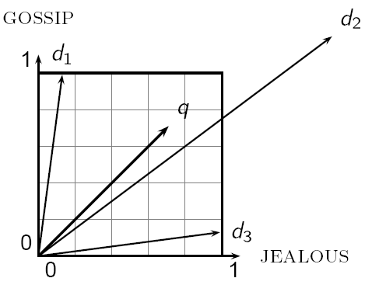
Why distance is a bad idea
The Euclidean distance between q
and d₂ is large even though the
distribution of terms in the query q and the distribution of
terms in the document d₂ are very similar.

Slide 61
Use angle instead of distance
Thought experiment: take a document d and append it to itself. Call this document d’’.
“Semantically” d and d′ have the same content
The Euclidean distance between the two documents can be quite large
The angle between the two documents is 0, corresponding to maximal similarity.
Key idea: Rank documents according to angle with query

Slide 62
From angles to cosines
The following two notions are equivalent.
Rank documents in decreasing order of the angle between query and document
Rank documents in increasing order of cosine(query,document)
Cosine is a monotonically decreasing function for the interval [0º, 180º]

Slide 63
Length normalization
A vector can be (length-) normalized by dividing each of its components by its length – for this we use the L₂ norm:
Dividing a vector by its L₂ norm makes it a unit (length) vector
on surface of unit hypersphere

Slide 64
Length normalization (cont’d)
Effect on the two documents d and d′ (d appended to itself) from earlier slide:
they have identical vectors after length-normalization
Long and short documents now have comparable weights

Slide 65
Cosine similarity between query and document
q_{i} is the tf-idf weight of term i in the query
d_{i} is the tf-idf weight of term i in the document
This the cosine similarlity of q and d

Slide 66
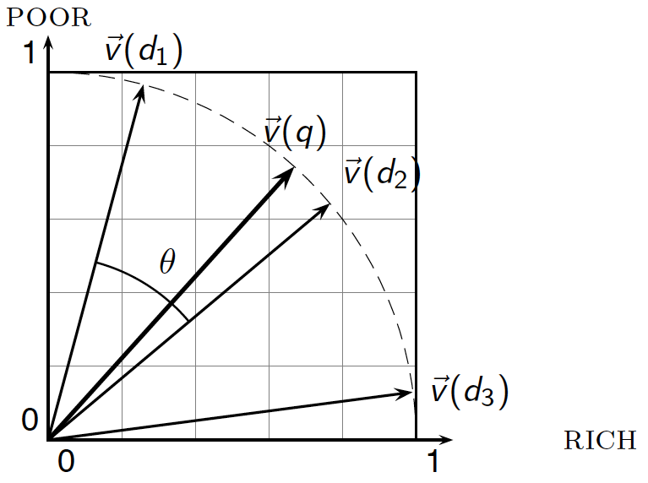
Cosine similarity illustrated

Slide 67
tf.idf weighting has many variants
Notes:
n default is just term frequency
ltc is best known form of weighting

Slide 68
Summary – vector space model and ranking
Represent the query as a weighted tf.idf vector
Represent each document as a weighted tf.idf vector
Compute the cosine similarity score for the query vector and each document vector
Rank documents with respect to the query by score
Return the top K (e.g., K = 10) to the user

Slide 69
An alternative: Okapi/BM25
Slide credit from here: M. de Rijke, UvA
Not the full theory
From idf weighting to BM25 in a few steps
Simplest score for doc d is idf weighting of the query terms present:
(RSV: retrieval status value, the “score”)
Next step, factoring in frequency of each term and document length:

Slide 70
Okapi/BM25
Here, tf_{td} is the tf of t in d and L_{d} and L_{ave} are the length of d and the average doc length for the whole collection
Parameters
k₁ is a positive tuning parameter that calibrates the doc term frequency scaling
b calibrates the doc length scaling

Slide 71
Okapi/BM25
If the query is long use weighting for query terms
tf_{tq}: frequency of t in q
k₃: tuning frequency scaling of query

Slide 72
Quiz: three key notions?
Many “document retrieval models” share three key ingredients:
Term frequency
A term is a better indicator of the contents of a document if it occurs more frequently in that document
Document frequency
Terms that occur in many documents are not good discriminators
Document length normalization
Longer documents are more likely to contain a term (without necessarily being “about” the term)

Slide 73
Query independent ranking
PageRank (named after Larry Page)
http://ilpubs.stanford.edu:8090/422/1/1999-66.pdf
Citation analysis: analysis of citations in the scientific literature
Example citation: “Miller (2001) has shown that physical activity alters the metabolism of estrogens.”
“Miller (2001)” is a hyperlink linking two scientific articles.

Slide 74
Query independent ranking
One application of these “hyperlinks” in the scientific literature:
Measure the similarity of two articles by the overlap of other articles citing them
This is called cocitation similarity
Key idea: Cocitation similarity on the web?

Slide 75
Link-based ranking for web search

Slide 76
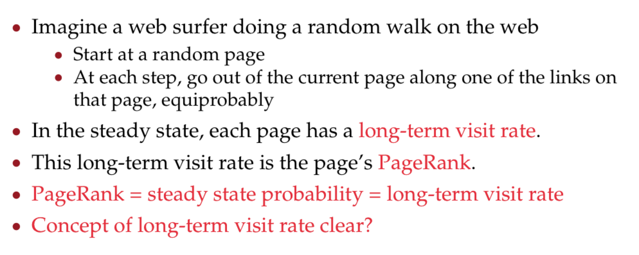
PageRank basis: random walk

Slide 77
Markov chains

Slide 78
Markov chains

Slide 79
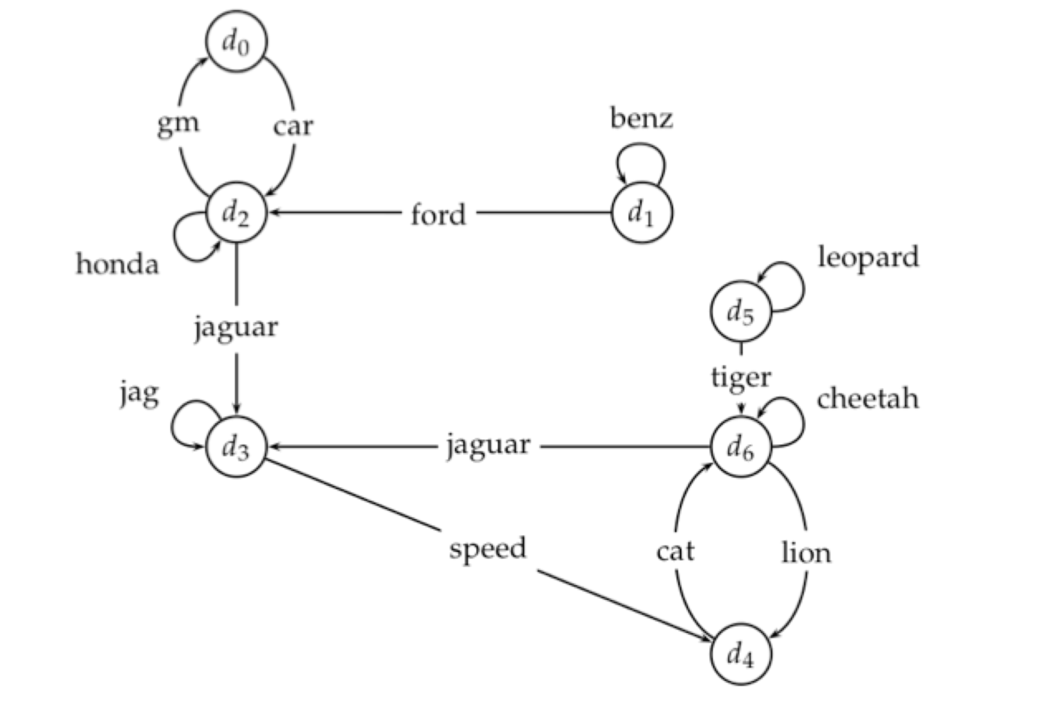
Example web graph

Slide 80
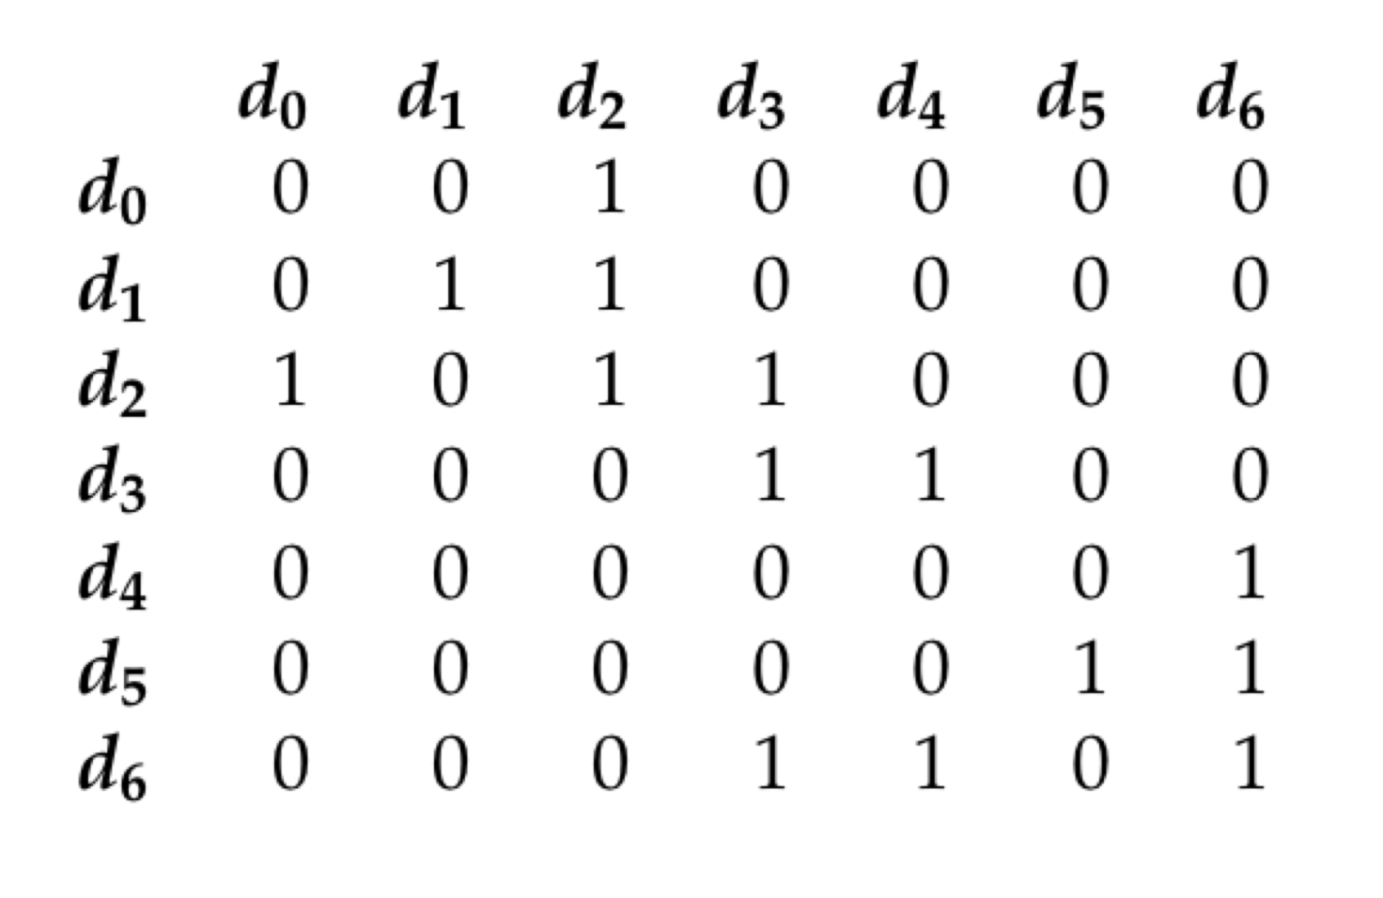
Link matrix for example

Slide 81
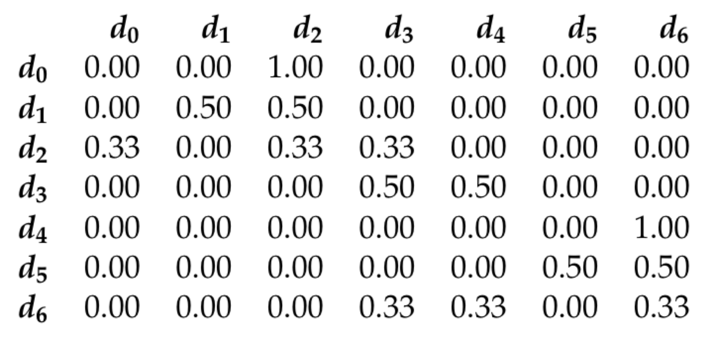
Transition matric for example

Slide 82
Long-term visit rate

Slide 83
Dead ends

Slide 84
Quiz: How to cope with dead ends?

Slide 85
Teleporting

Slide 86
Result of teleporting

Slide 87
Ergodic Markov chains

Slide 88
Ergodic Markov chains

Slide 89
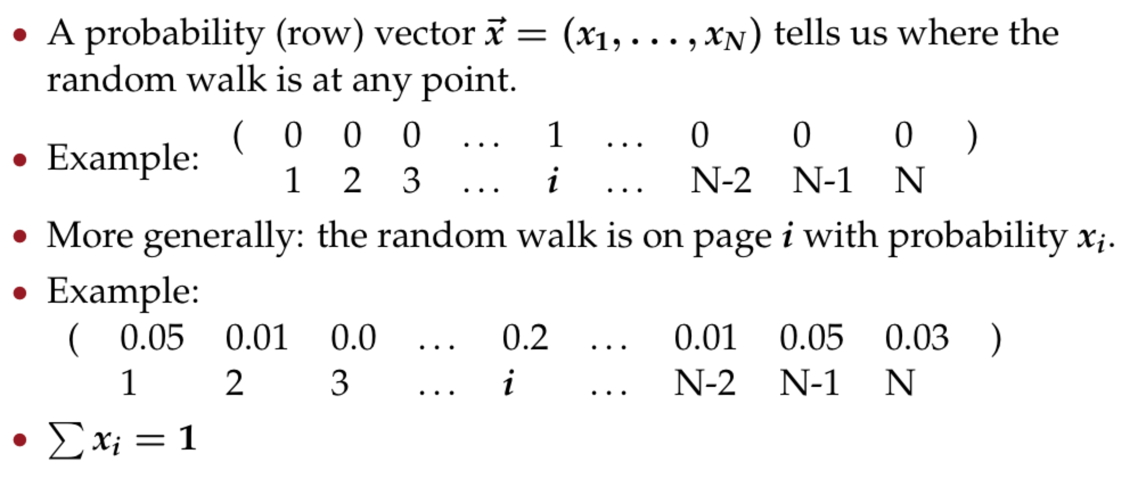
Formalization of “visit”

Slide 90
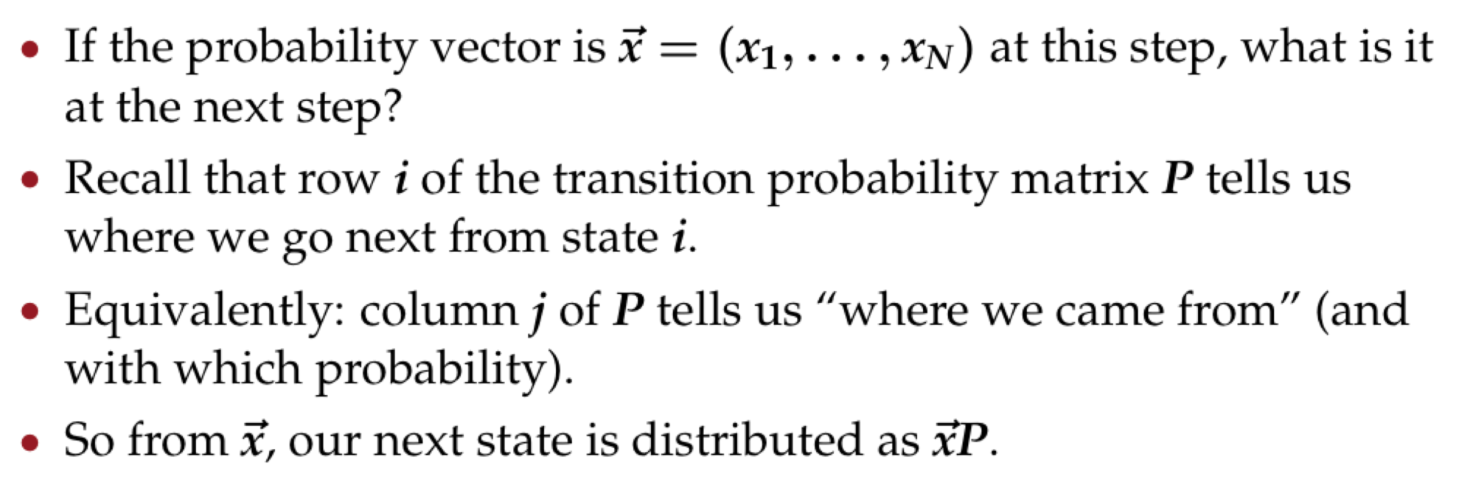
Change in probability vector

Slide 91
Steady state in vector notation

Slide 92
How do we compute the steady state vector?

Slide 93
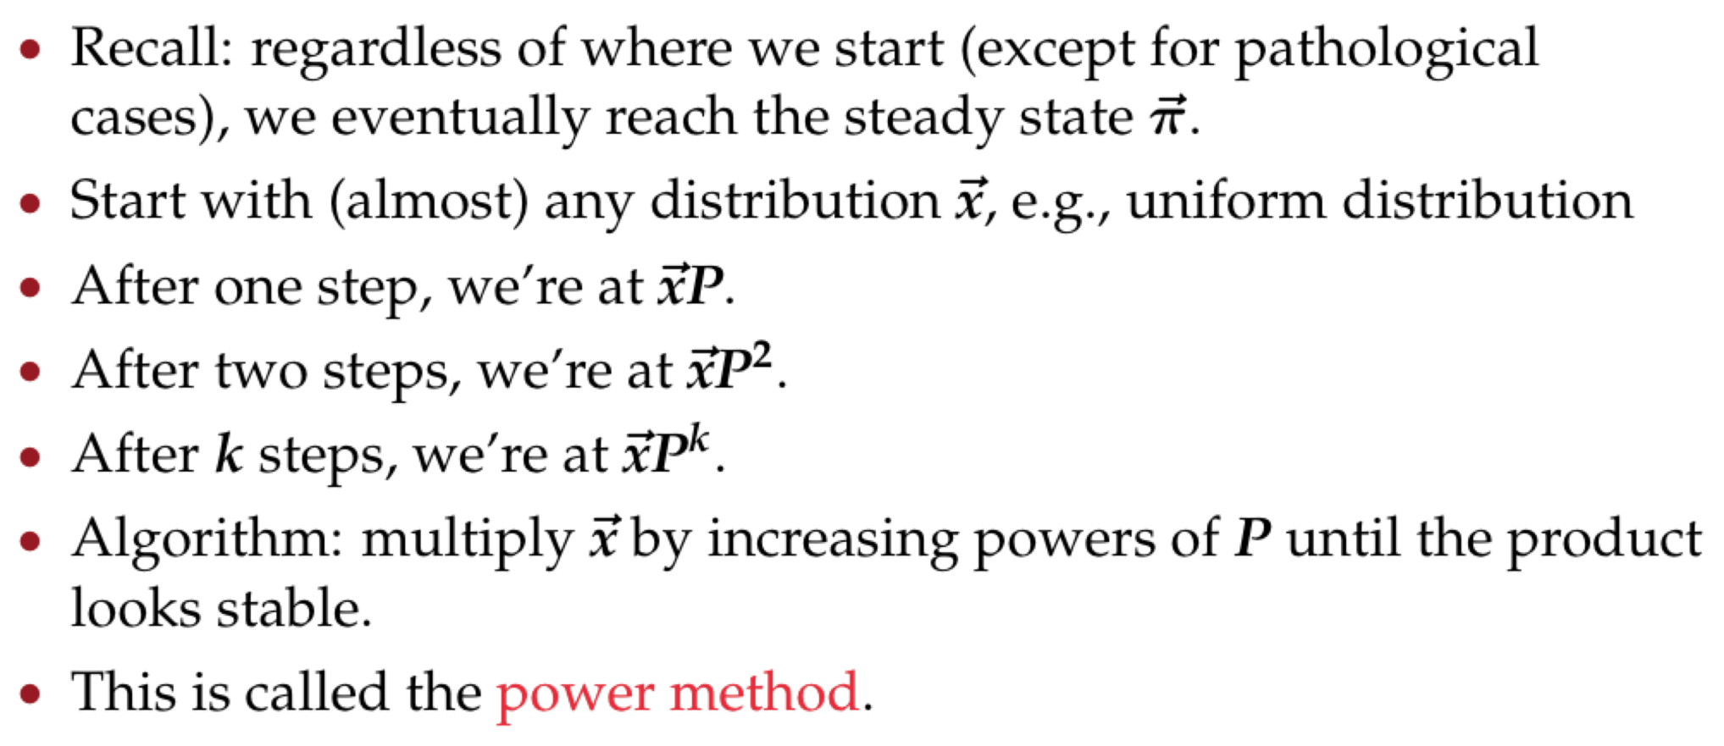
One way of computing the PageRank

Slide 94
Power method: Example

Slide 95
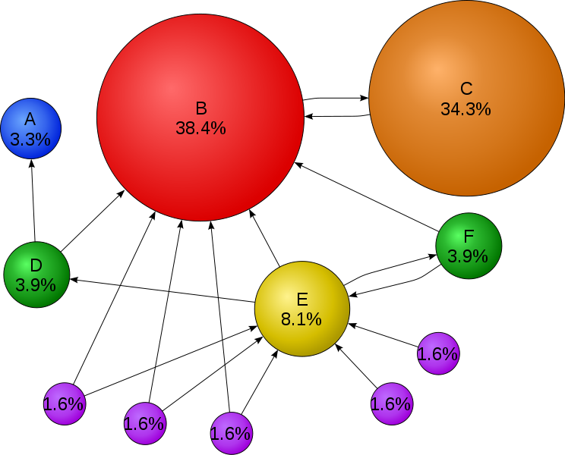
Quiz: page rank
Why is website C’s page rank higher than E’s?

Slide 96
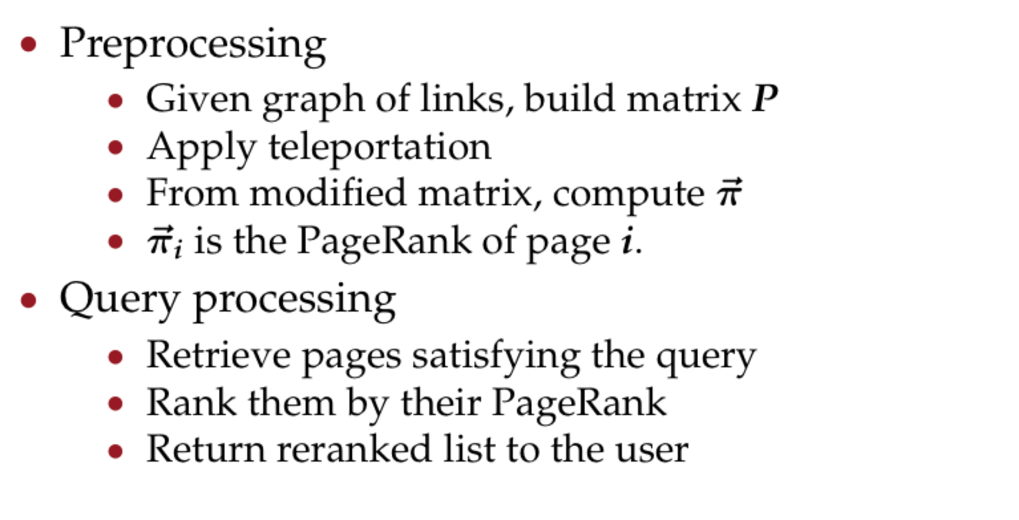
PageRank summary

Slide 97
PageRank issues

Slide 98
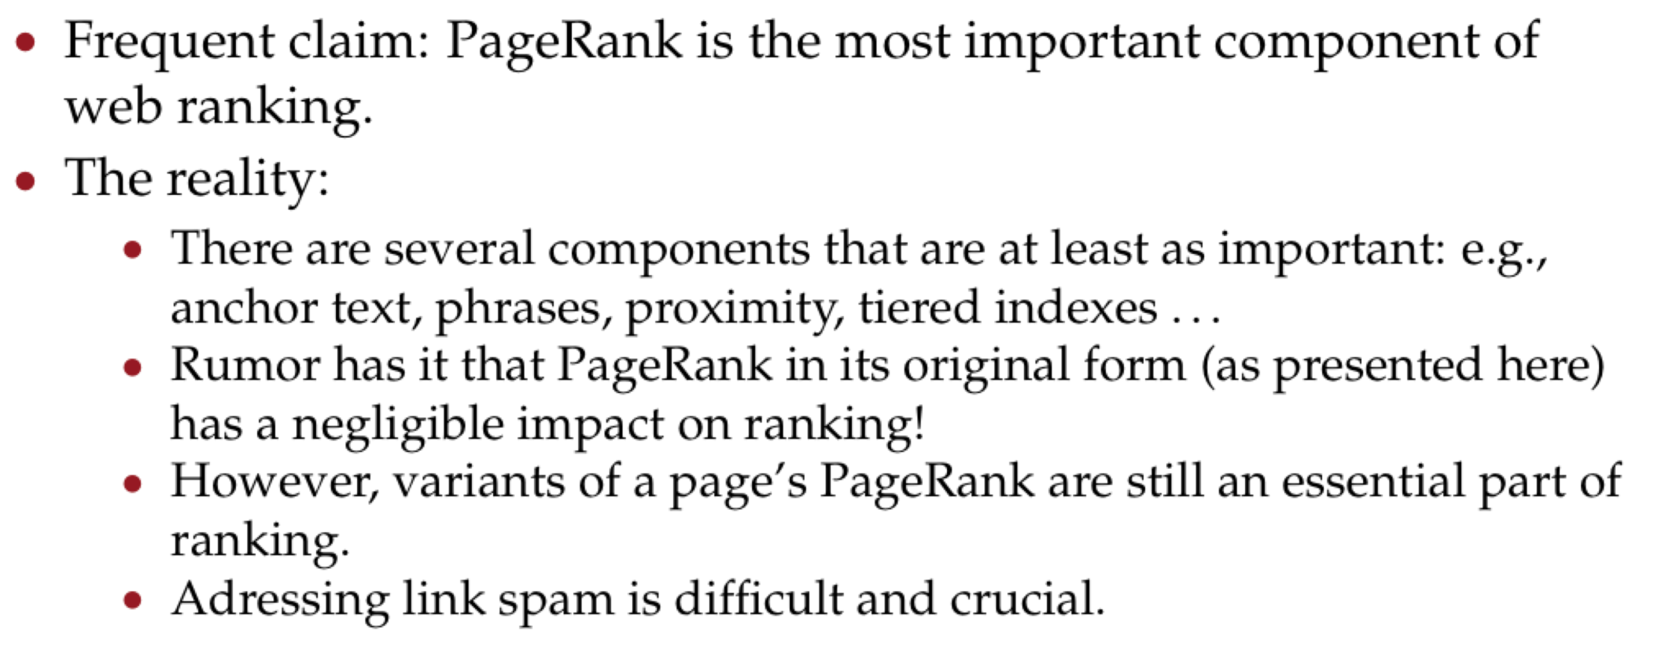
How important is PageRank?

Slide 99
Next week
We will start from simple visual representations of an image

Slide 100
Acknowledgements
Information Retrieval slide credit:
C. Manning and P. Raghavan, Stanford University
M. de Rijke, University of Amsterdam

