Slide 1
CS598 Visual Info. Retrieval
Words and Pictures
Slides tailored from Cees

Slide 2
Lecture IX
Part I: Matching Words and Pictures
By Kobus Barnard
University of Arizona

Slide 3
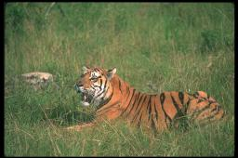
Visual Representation
Semantic Representation
A tiger lying in the grass

Slide 4
Visual Representation
Semantic Representation
grass
tiger

Slide 5
Recap: concept detection
Finding words for the images
tiger grass cat
See lecture on concept detection
Notes:
In our previous work, we predicted words for the images.
This process, which we called auto-annotation is useful itself,
because it is common to index images using manual annotations, and
If one can predict these annotations then one can save considerable work.
However, there is a big difference between annotation and recognition.
It doesn’t tell us which image structure give rise to which word.
That is we don’t know where the word goes.
This follows our previous work, where we predict words for the images.
It is suggestive of recognition but it is not.

Slide 6
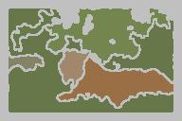
Concept detection vs Recognition
?
tiger cat grass
Notes:
However, there is a big difference between annotation and recognition.
It doesn’t tell us which image structure give rise to which word.
That is we don’t know where the word goes.
We know that tiger, cat and grass are in the image,
but we don’t know which region gets tiger, which gets cat, and which gets grass.
It is hard to tell this with one picture.
Butt if we have other pictures where we have tiger blob without green blobs, then
we would be able to tell that orange stripy blob is tiger, not the green one.

Slide 7
Recognition
Semantic representation includes not only what is there, but where it is
Notes:
However, there is a big difference between annotation and recognition.
It doesn’t tell us which image structure give rise to which word.
That is we don’t know where the word goes.
We know that tiger, cat and grass are in the image,
but we don’t know which region gets tiger, which gets cat, and which gets grass.
It is hard to tell this with one picture.
Butt if we have other pictures where we have tiger blob without green blobs, then
we would be able to tell that orange stripy blob is tiger, not the green one.

Slide 8
General Approach
Learn models for annotation and recognition from large image data sets with associated text
Notes:
However, there is a big difference between annotation and recognition.
It doesn’t tell us which image structure give rise to which word.
That is we don’t know where the word goes.
We know that tiger, cat and grass are in the image,
but we don’t know which region gets tiger, which gets cat, and which gets grass.
It is hard to tell this with one picture.
Butt if we have other pictures where we have tiger blob without green blobs, then
we would be able to tell that orange stripy blob is tiger, not the green one.

Slide 9
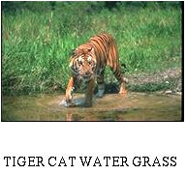
Key Point
Learn from data without explicit correspondence between image components
Data with correspondence ambiguity is common
  Images with associated text
  Video (which frame goes with which speech or text)
Notes:
However, there is a big difference between annotation and recognition.
It doesn’t tell us which image structure give rise to which word.
That is we don’t know where the word goes.
We know that tiger, cat and grass are in the image,
but we don’t know which region gets tiger, which gets cat, and which gets grass.
It is hard to tell this with one picture.
Butt if we have other pictures where we have tiger blob without green blobs, then
we would be able to tell that orange stripy blob is tiger, not the green one.

Slide 10
Key Point (cont)
Trade quality for quantity (and realism)
Sources of information
  A word (tiger) is much more likely than chance to have something to do with the image
  If a word refers to something in the image (tiger), it is less likely to refer to something else
  Relationship between visual information and words has structure across images
Notes:
However, there is a big difference between annotation and recognition.
It doesn’t tell us which image structure give rise to which word.
That is we don’t know where the word goes.
We know that tiger, cat and grass are in the image,
but we don’t know which region gets tiger, which gets cat, and which gets grass.
It is hard to tell this with one picture.
Butt if we have other pictures where we have tiger blob without green blobs, then
we would be able to tell that orange stripy blob is tiger, not the green one.

Slide 11
Statistical Machine Translation
Data: Aligned sentences, but word
correspondences are unknown
“the beautiful sun”
“le soleil beau”
Brown, Della Pietra, Della Pietra & Mercer 93
Notes:
This problem is very similar to building a dictionary for machine translation. We have bunch of aligned english and french sentences
But we don’t know which english word is the translation of which french word.
With one sentence we cannot say anything. But if we have
The beautiful sun, beautiful dog, beautiful girl…
Then, we can learn that beautiful goes to beau not to soleil or le.

Slide 12
Quiz: How to learn word correspondences?
With one sentence we cannot say anything. But if we have
The beautiful sun, beautiful dog, beautiful girl…
Then, we can learn that beautiful goes to beau not to soleil or le.

Slide 13




Basic idea:
Multimedia Translation
“sun sea sky”
Notes:
So, translating french to english is very similar to our problem, where we want
To translate visual data into words
After having the basic idea, now we can go in detail.

Slide 14
Approaches
Discretize (tokenize) blobs [ Duygulu, Barnard, de Freitas, Forsyth, ECCV 02]
Simultaneously learn blob models and translation [ Barnard et al, JMLR 03 ]
Multiple instance learning with support vector machines [ Andrews et al, NIPS 02]
Integrate context into features [ Barnard et al. CVPR 03] and into the model [Carbenetto et al. 03]
Composite models [ Barnard et al. CVPR 03, Wachsmuth et al, 03]
Notes:
To exploit the analogy with machine translation we replaced the image regions with tokens
To do this,
we applied k-means to cluster our feature space,
and then we chose the closest center for each region to find its blob token

Slide 15
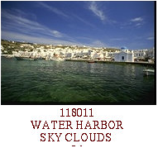
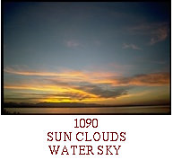
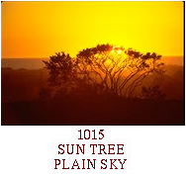
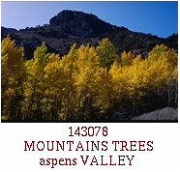
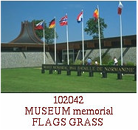
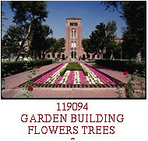
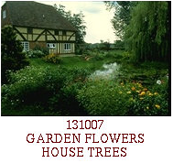
Corel Database
392 CD’s, each consisting of 100 annotated images.
Notes:
One of them is Corel database which is a very large collection of stock photographs taken by professional photographers
We have about 40000 images and each image is associated with a few keywords

Slide 16

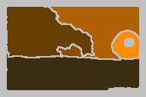
Input
Image
processing*
sun sky waves sea
Each region is described by a set of features
Region size
Position
Color
Oriented energy (12 filters)
Simple shape features
*
Thanks to Blobworld team [Carson, Belongie, Greenspan, Malik], N-cuts team [Shi, Tal, Malik]
Notes:
We segment the images into regions using Normalized Cuts software developed in Berkeley
Then, we represent the 8 largest regions in each image by 40 futures including
Size, position, color, texture and shape.
Our choice of features are arbitrary. We expect better or worse behavior would be available
Using different sets of features.

Slide 17
Discrete Model [ECCV 02]
Straightforward adaptation of machine translation
Need to vector quantize blobs (simple but better to simultaneously learn blob model)

Slide 18
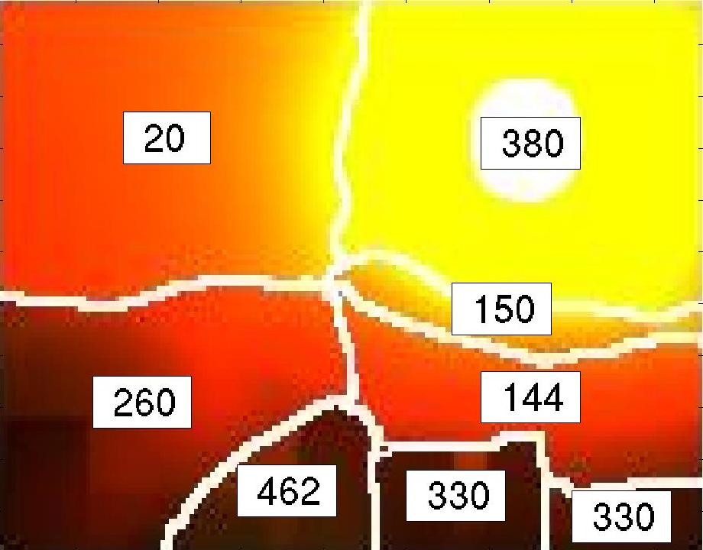
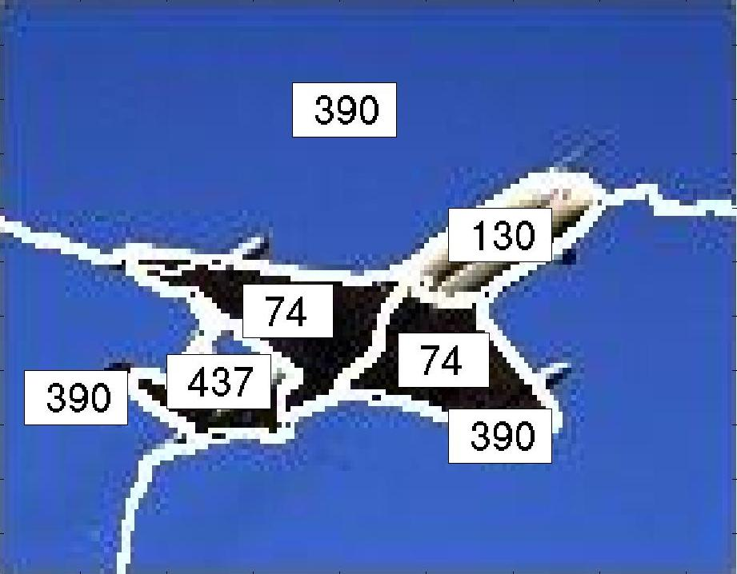
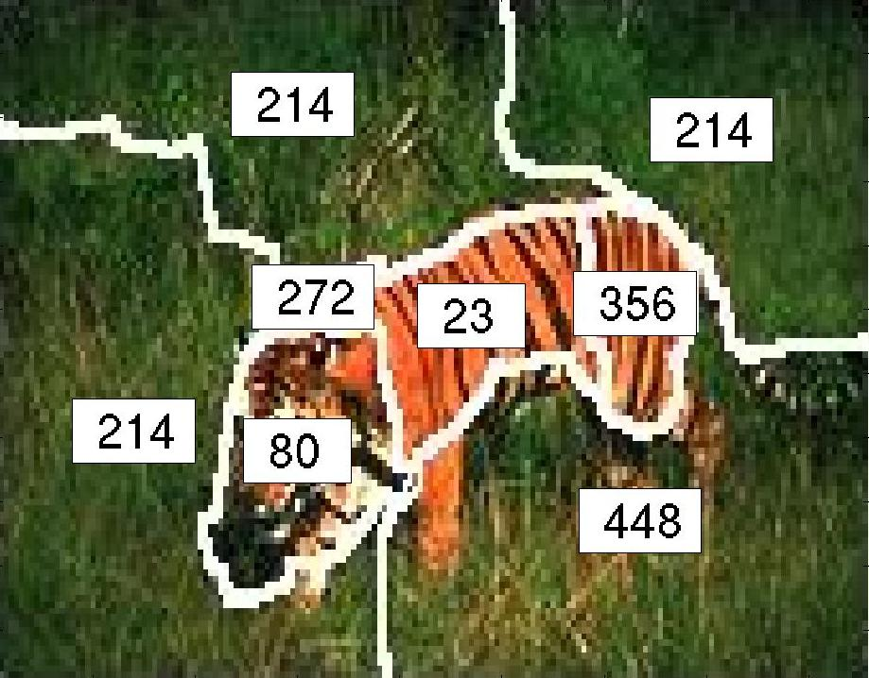
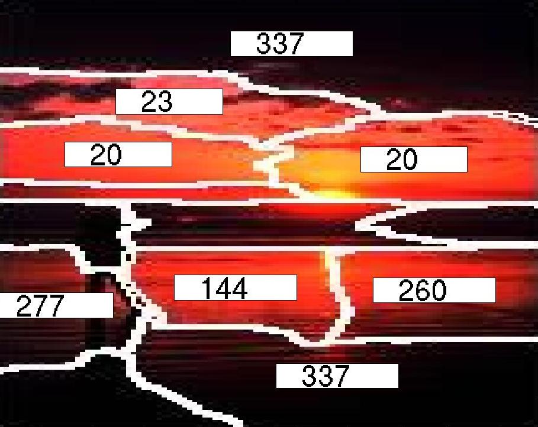
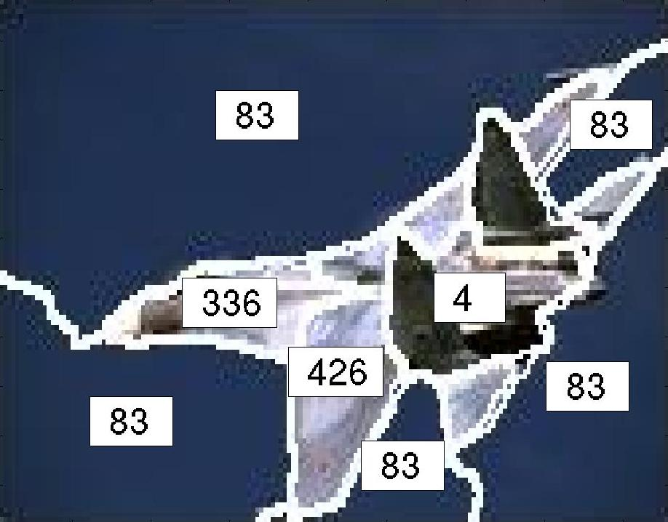
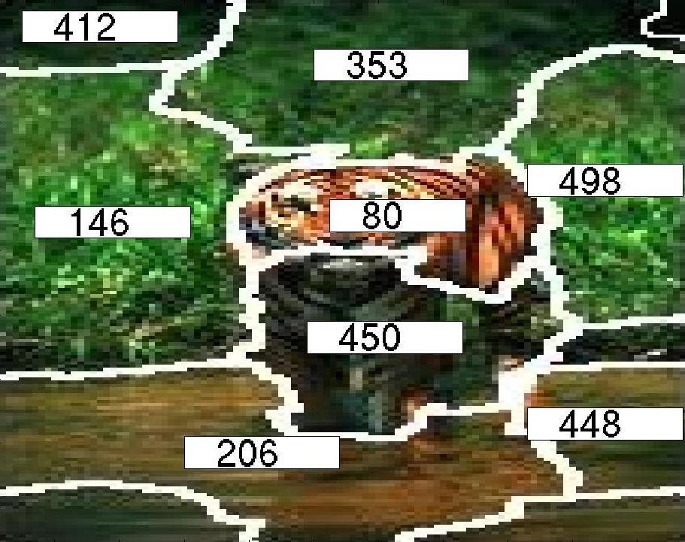
city mountain sky sun
jet plane sky
cat forest grass tiger
beach people sun water
jet plane sky
cat grass tiger water

Slide 19








Dictionary
Most probable
word
Blobs for three blob tokens
sun
sky
cat

Slide 20

Initialization
sun
sea
Initialize translation table
to blob-word co-occurrences
(empirical joint distribution of blobs and words)
.
.
.
.

Slide 21
Expectation Maximization
Given the translation probabilities estimate
the correspondences
Given the correspondences
estimate the translation probabilities
Dempster et al., 77
Notes:
In order to this, we apply EM which alternates between two activities .
Now we will look in detail.

Slide 22
Why does this work?
Co-occurrence is a sensible starting point
EM process sharpens probabilities by integrating dictionary with constrained choices
Notes:
So, after EM we have translation table.
Now, let’s look how we can use it
When we have a new image from the held out, we can apply a similar process.
we segment the image and then
We find the blob token for each region
Then, we look at the posteriors for the given blob using the translation table.

Slide 23
More general models

Slide 24
More general models
Generate words by frequency table
Generate blobs by Gaussian over features
(Conditionally independent given node)

Slide 25
joint visual/textual concepts
blob
word
Learn p(w|l), p(b|l), and p(l) from data using EM

Slide 26
More general models
sky
sea waves
sun

Slide 27
More general models
sky
sea waves
sun
sky sea waves sun

Slide 28
Labeling Regions
Segment the image
Use model to compute P(word | region )
Notes:
So, after EM we have translation table.
Now, let’s look how we can use it
When we have a new image from the held out, we can apply a similar process.
we segment the image and then
We find the blob token for each region
Then, we look at the posteriors for the given blob using the translation table.

Slide 29
Labeling Regions
tiger
cat
forest
grass
horse
sun
grass
forest
tiger
cat
horse
sun

Slide 30
Labeling Regions
Display only maximal probable word
tiger
forest
cat
grass
horse
sun
tiger
Notes:
Now, let’s choose the maximal probable word for each blob and write it on the blob.

Slide 31
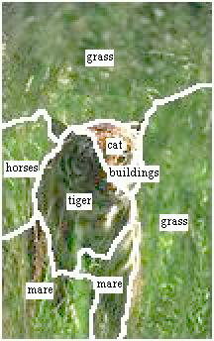
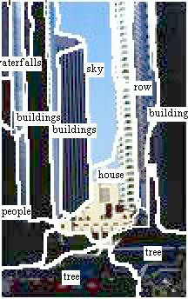
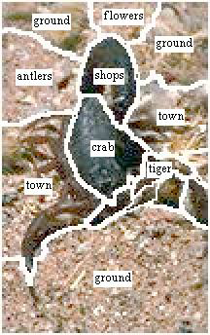
Results

Slide 32
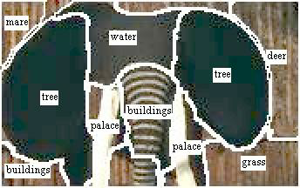
Failure case
Notes:
And, what about this image. This a sculpture of an elephant. All the words that we predicted are wrong.
tree for the ears, buildings, water.
But, we don’t expect to solve it for a while.

Slide 33
Measuring Performance
First strategy--score by hand
Second strategy--use annotation performance as a proxy.
Notes:
It is nice to look at the images, but we need some numbers to understand how well we are doing.
But, how can we measure?
One strategy is scoring by hand
And the other is doing it automatically using annotation performance

Slide 34
First Strategy
Score by hand
Average performance is four times better than guessing the most common word
(“water”)
Not very scalable….
Notes:
To score by hand means, looking the images, and checking the ones which are correct.
For example, in this image we have predicted tiger, cat and grass correctly.
We need to answer two questions.
-do I predict the right words
-are they in the right place
Scoring by hand answers but of those questions.
But, it is very hard to do this with a large volume.
So, we need a better way to do it automatically.

Slide 35
Second Strategy
Use Annotation
tiger cat grass water
Automatic : Don’t need to do by hand
Notes:
We can use our annotation results for that.
Now, we predict words for the images, so we cannot answer the second question.
But it is automatic, and we can score lots of results.

Slide 36
Annotating Images
. . .

Slide 37
Measuring Annotation Performance
Actual Keywords
GRASS TIGER CAT FOREST
Predicted Words
CAT HORSE GRASS WATER

Slide 38
Measuring Annotation Performance
Actual Keywords
GRASS TIGER CAT FOREST
Predicted Words
CAT HORSE GRASS WATER

Slide 39
Exploiting Word Prediction
Model Selection
Segmentation
Feature choices

Slide 40
Blobworld segmentations
N-cuts segmentations

Slide 42
Some Applications
Using text search engines to find images without keywords (P(image|word))
Browsing and searching image parts

Slide 43
More Applications
Building a face gazetteer from news photos
Indexing and linking news stories using pictures
Linking news articles and news video using pictures

Slide 44
More Applications
Augmenting/combining information across the domains
Learning relationships across domains

Slide 45
Learning Relationships
Plausible tag learnt using U.S. news corpus
Jacques Chirac

Slide 46
Learning Relationships
Plausible tag learnt using U.S. news corpus
Plausible tag learnt using French news corpus
Jacques Chirac
Monsieur le president

Slide 47
Learning Relationships
Plausible tag learnt using U.S. news corpus
Plausible tag learnt using French news corpus
Jacques Chirac
Monsieur le president

Slide 48
Learning Relationships
Plausible tag learnt using U.S. news corpus
Plausible tag learnt using French news corpus
Jacques Chirac
Monsieur le president

Slide 49
Useful ways to ‘cheat’
For some applications, good absolute performance may not be needed.
Image retrieval: Give the user multiple results
If words are available for test image, labeling improves

Slide 50
Held out data, no words allowed (pure vision task).
Held out data, no words allowed (useful for browsing/retrieval).

Slide 51
Useful ways to ‘cheat’
3) Word sense disambiguation with pictures [NAACL/HLT-WSM 2003]

Slide 52
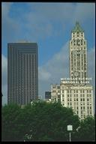
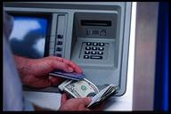

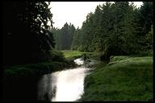
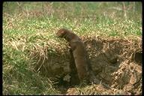
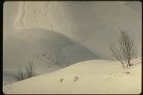
The Word Sense Disambiguation Problem
212001 bank buildings trees city
125090 bank machine money currency bills
125084 piggy bank coins currency money
26078 water grass trees banks
173044 mink rodent bank grass
151096 snow banks hills winter

Slide 53
Conjecture
Images illustrating text can help
The man ate his lunch down by the bank.

Slide 54
Combining Sources

Slide 55
P(s|I)

Slide 56
P(s|w,I)
(the ‘cheat’)

Slide 57
Preliminary Testing
Problems with Corel
  Not much ambiguity
  Keywords not disambiguated
Culled the database to a subset
  Images with one or more ambiguous keywords
  Hand-labeled the subset
More criticism on Corel in lecture on benchmarking….

Slide 58
Results
Word sense disambiguation strategy | Score
Naïve text based method | 0.858 (0.008)
Random sense choice | 0.875 (0.012)
Image and text method | 0.948 (0.015)
However…
  Dataset (culled Corel) not very ambiguous
  WSD algorithm simplistic
    Better algorithm might not need help from images

Slide 59
Comments on recognition vs annotations
Learning on data without correspondence is a good trick BUT there are fundamental problems
Intuitively the words are generated through the parts (regions, groups), but the error function refers to the whole.
Need a better theory of how to link the two.

Slide 60
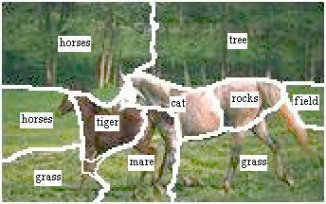
Integrating Supervision
Estimate where a minimal amount of supervision can be most helpful.

Slide 61

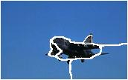
Integrating Feature Selection
Propose good features to differentiate words that are not distinguishable (e.g., eagle and jet)

Slide 62
Integrating Vision Levels
Word prediction gives a new way to think about integrating high and low level vision processes

Slide 63
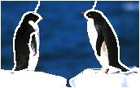
Region Merging

Slide 64
Region Merging
Use word posteriors to propose region merges
Recompute descriptors for the conglomerate object (color histograms, shape descriptors)
Have the system learn what kinds of “familiar configurations” are useful (i.e. lead to better word prediction)

Slide 65
Preliminary Experiment
[ CVPR, 03 ]
Good merge
Poor merge

Slide 66
More Complex Semantics
Current system links uniform blobs to simple nouns
Working towards linking groups of blobs to nouns, relations to prepositions, and attributes to adjectives

Slide 67
Summary
Recognition on the large scale
Unsupervised - label without labeled training data
Learn what to recognize
Semantic evaluation of vision tools
Integrating vision processing levels

Slide 68
Bottom Line
Recognition as machine translation
Machine vision as data-mining

Slide 69
Lecture IX: Words and Pictures
Part II: Learning social tag relevance
Xirong Li, Cees G.M. Snoek, and Marcel Worring
Intelligent Systems Lab Amsterdam
University of Amsterdam

Slide 70
Today’s roadmap
Matching words and pictures
Names and faces in the news
Learning social tag relevance

Slide 71
Learning social tag relevance
Xirong Li, Cees G.M. Snoek, and Marcel Worring
Intelligent Systems Lab Amsterdam
University of Amsterdam

Slide 72




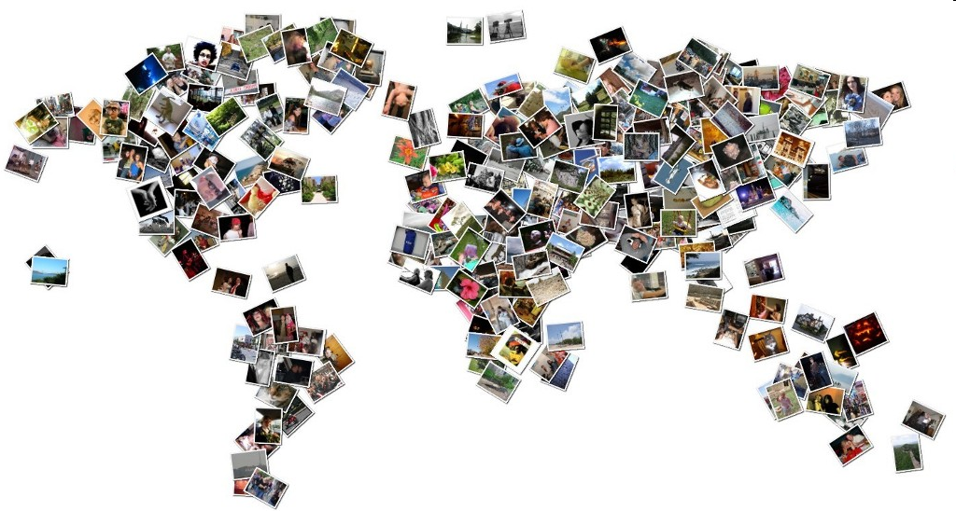
Worldwide social-tagged visual data
Emerging data
  Billions of social-tagged images
Emerging research
  Broad interest in multiple fields*
    MM,CVPR,CIVR,MIR,ICME,WWW,KDD,…
  CIVR’10: one keynote, two oral sessions
…
*Query google scholar with “social image retrieval”

Slide 73
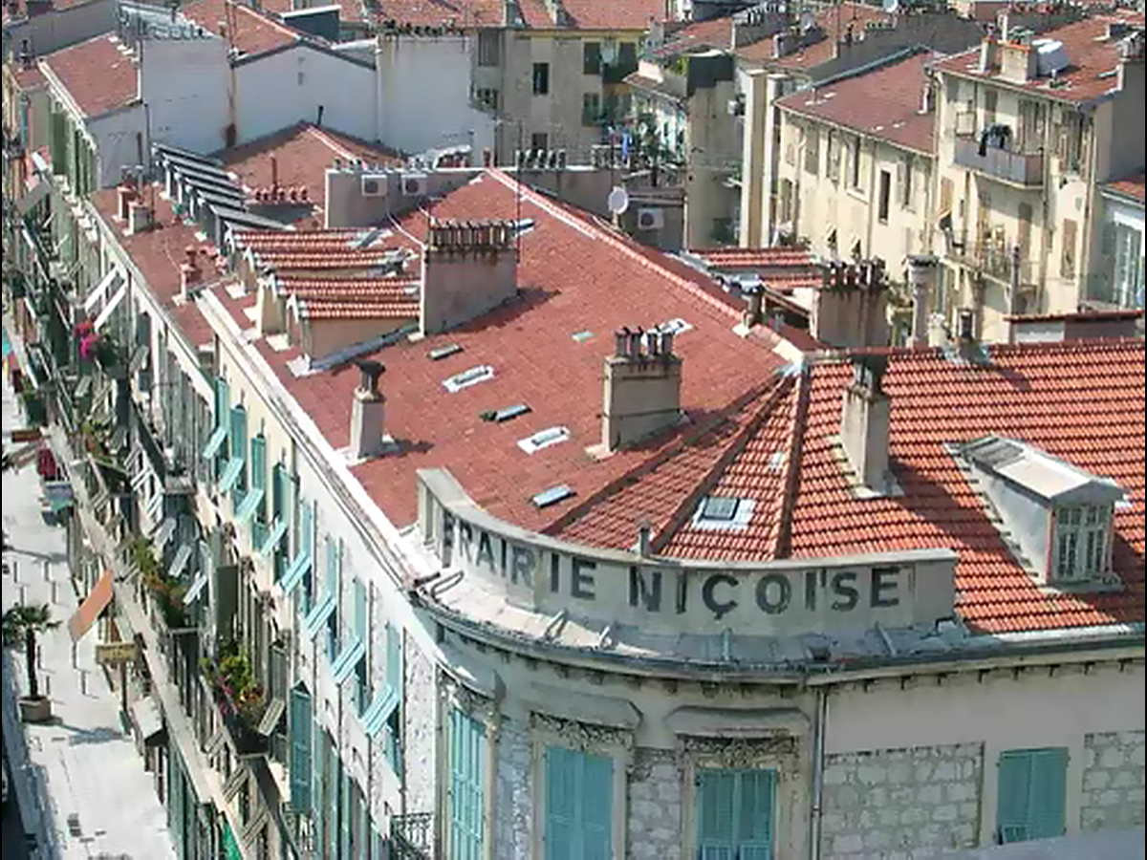
Demo: What is on Flickr?

Slide 74
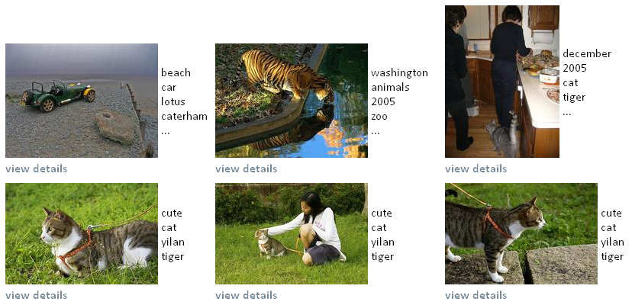
But, image retrieval results are poor
Key problem: Social tagging is subjective
  User tags might be irrelevant to the visual content
Query tiger
x
x
x
x
x

Slide 75
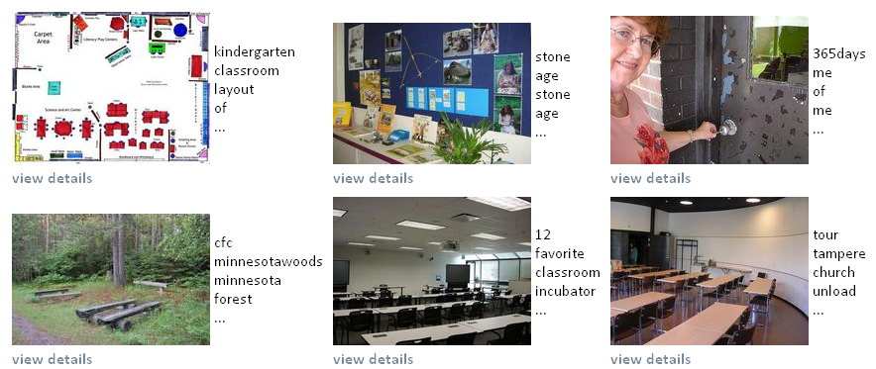
But, image retrieval results are poor
Key problem: Social tagging is subjective
  User tags might be irrelevant to the visual content
Query classroom
x
x
x
x

Slide 76
Query-dependent methods
Search results re-ranking^{[Hsu’07,…]}
Combining multiple textual features^{[Olivares’08,…]}
  tags, titles, notes,…

Slide 77
Query-independent methods
Tag relevance learning[Our work Li’08,Li’09] and later [Liu’09,Wu’09,Kennedy’09,Xu’09,…]
  Estimating the relevance of a tag with respect to the visual content
bridge
bicycle
perfect
MyWinners
x

Slide 78
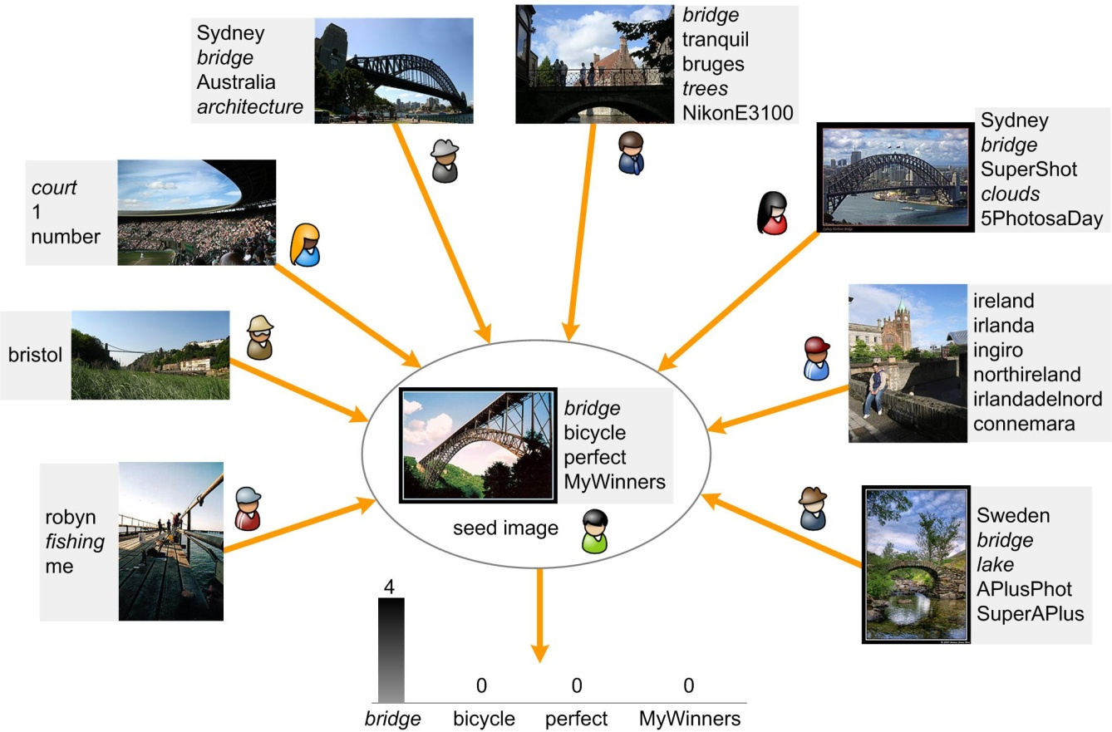
Learning tag relevance by neighbor voting^{[Li’08,Li’09]}
  Exploiting the wisdom of multiple users in social image tagging
Need visual features to describe the content and to measure visual similarity.
The semantic gap challenge
The semantic gap:
Mismatch between visual similarity and semantic similarity.
Voting results
Notes:
78

Slide 79
Intuition
The semantic gap is tag-dependent and feature-dependent^{[Lu’10]}
sunset
ocean
bridge
nature
instantfave
scenery
Objective tags

Slide 80
Intuition cont.
The semantic gap is tag-dependent and feature-dependent
For color features, sunset has a smaller semantic gap than other tags
sunset
ocean
bridge
nature
instantfave
scenery

Slide 81
Intuition cont.
The semantic gap is tag-dependent and feature-dependent
The spatial structure feature does not work in this example
sunset
ocean
bridge
nature
instantfave
scenery

Slide 82
Intuition cont.
The semantic gap is tag-dependent and feature-dependent
For bag-of-words features, bridge has a smaller semantic gap than other tags
sunset
ocean
bridge
nature
instantfave
scenery

Slide 83
From intuition to algorithm
Multi-feature tag relevance learning
?

Slide 84

General framework
image
tag
Single-feature tag relevance learners
We seek a convex combination
specific feature
specific parameter:
the number of neighbors for voting
A good choice for combining classification/ranking models^{[Freund’03,Hastie’01]}
Combination weights

Slide 85
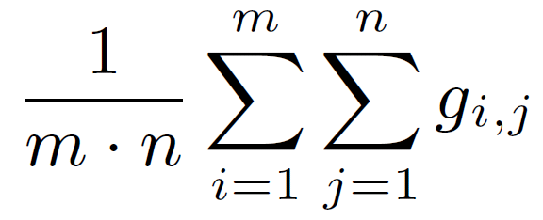
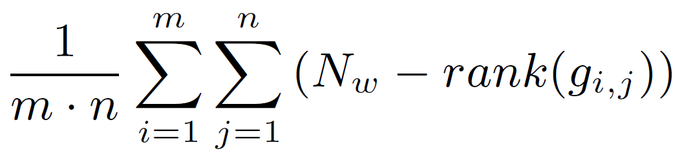
Unsupervised combination methods
Uniform weights
  Following the principle of maximum entropy^{[Jaynes’03]}
  We term the method UniformTagger
Borda Count
  A well-known rank aggregation algorithm^{[JC de Borda, 1770]}

Slide 86
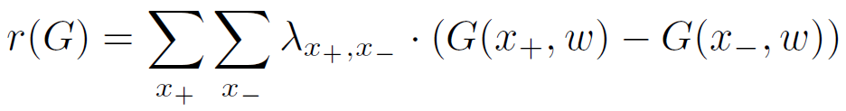
Supervised combination methods
Supervised
  Best Single Learner^{[Li’09]}
  Weighted Borda Count^{[Aslam’01]}
  RankBoost^{[Freund’03]}
The objective function to maximize
pairwise weight
ranking gain
the larger the better

Slide 87
Questions to answer
Is multi-feature better than single-feature for learning tag relevance?
Compared to the supervised combination methods, how much do we lose when using the unsupervised combination methods?

Slide 88
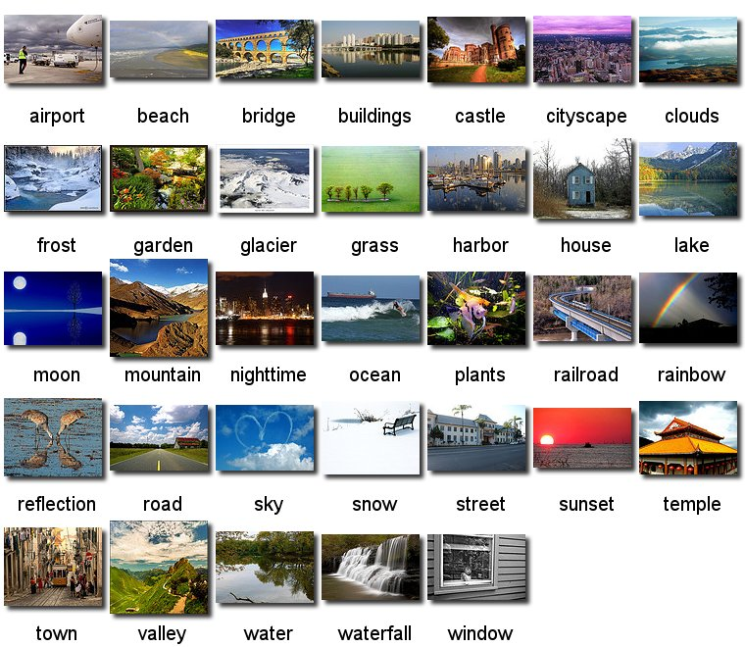
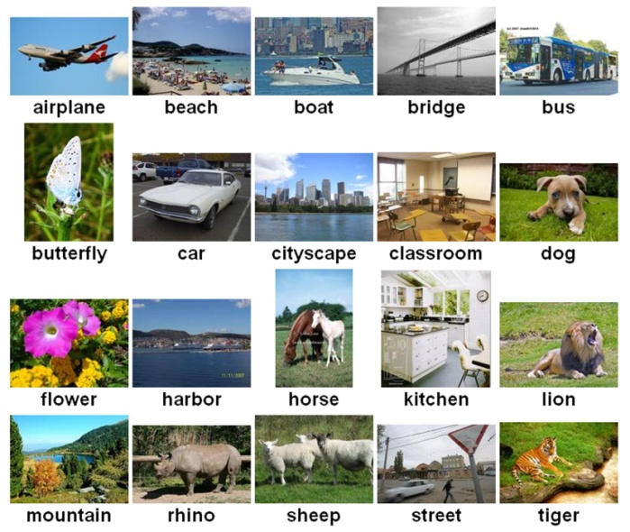
Experimental setup
Two ground truth query sets for evaluation
Neighbor voting set
  3.5 million social-tagged images randomly collected from Flickr²
NUS-SCENE¹: 33 concepts, ~34,000 images
Social20²: 20 concepts, ~20,000 images
¹http://lms.comp.nus.edu.sg/research/NUS-WIDE.htm
²http://staff.science.uva.nl/~xirong/tagrel/

Slide 89
Experimental setup cont.
Visual features
Parameters of base tag relevance learners
  Number of neighbors: {500,1000,1500,2000,2500} → 3x5=15 base learners
Approximate visual neighbor search on large data sets
  K-means based indexing
Evaluation criteria
  average precision, mean average precision
Feature | Granularity | Dim | Descriptions
Color64^{[Huang’99,Yu’02]} | global | 64 | color correlogram + texture moment + color moment
GIST^{[Oliva’01]} | global | 960 | dominant spatial structure of a scene
Dense-SURF^{[Bay’08,Uijlings’09]} | local | 4000 | bag-of-keypoints: dense sampling + SURF descriptor

Slide 90
Experiment 1: Unsupervised image retrieval
Tag Baseline
  Given a concept, rank images according to the concept’s occurrence frequency in descending order.
Single-feature tag relevance baseline
  Update tag frequency with learned tag relevance values
Two unsupervised combination methods
  UniformTagger
  Borda Count

Slide 91
Results of experiment 1 (on Social20)
UniformTagger beats tag baseline and single-feature tag relevance learning.
  47.6% relative improvement over tag baseline.
  8.6% relative improvement over single-feature.
  14 out of 20 concepts have more than 5% relative improvement.

Slide 92
Experiment 2: Supervised image retrieval
For each concept, we train the combination weights {α_{i,j}} using
  Best Single Learner
  Weighted Borda Count
  RankBoost

Slide 93
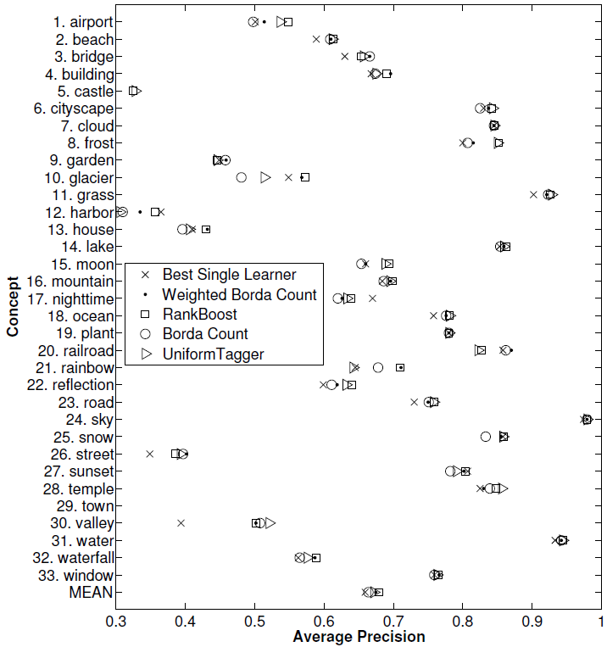
Results of experiment 2 (on NUS-SCENE)
Performance comparison
RankBoost > Weighted BordaCount > Best Single
UniformTagger is surprisingly comparable to RankBoost.
  RankBoost MAP: 0.679
  UniformTagger MAP: 0.672
  For only 4 out of 33 concepts, RankBoost outperforms UniformTagger, with over 5% relative improvement.
Our explanation
  RankBoost might over-emphasize over-confident base learners.
  Base learners complement each other and perform reasonably well in general.

Slide 94
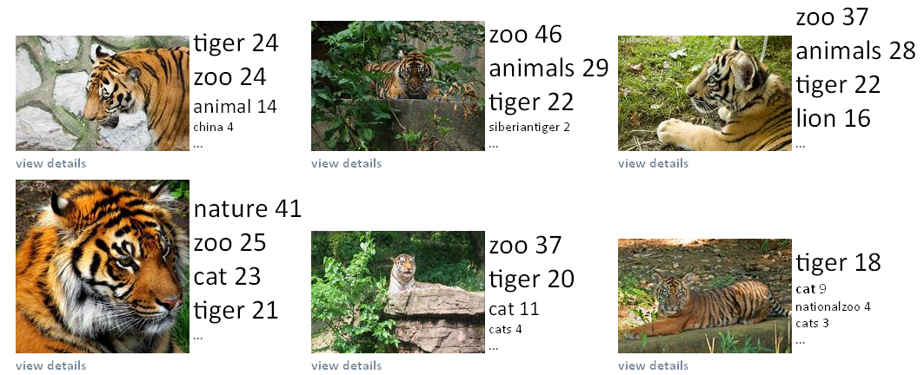
Image search after tag relevance learning
Objective social tagging ➔ Accurate image retrieval results
Query tiger

Slide 95
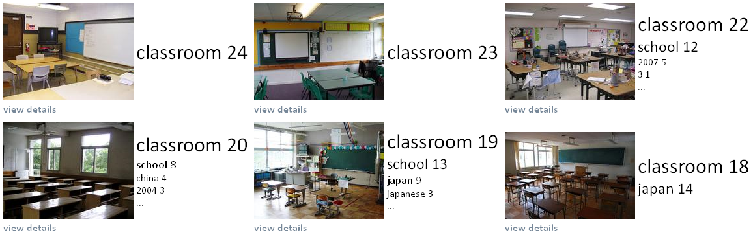
Image search after tag relevance learning
Objective social tagging ➔ Accurate image retrieval results
Query classroom

Slide 96
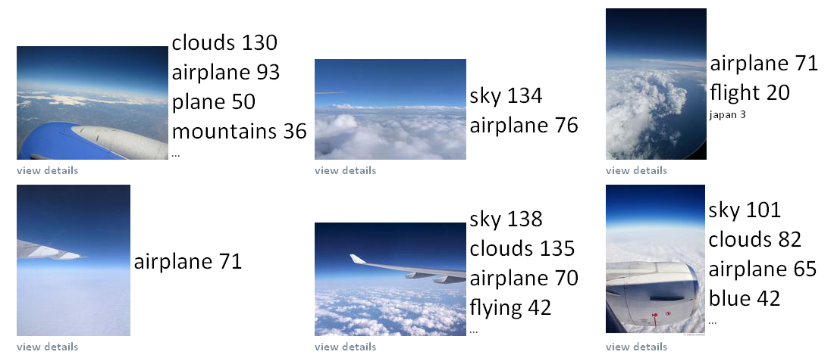
Failure case
Many users label these images with the tag “airplane”….
Query airplane

Slide 97
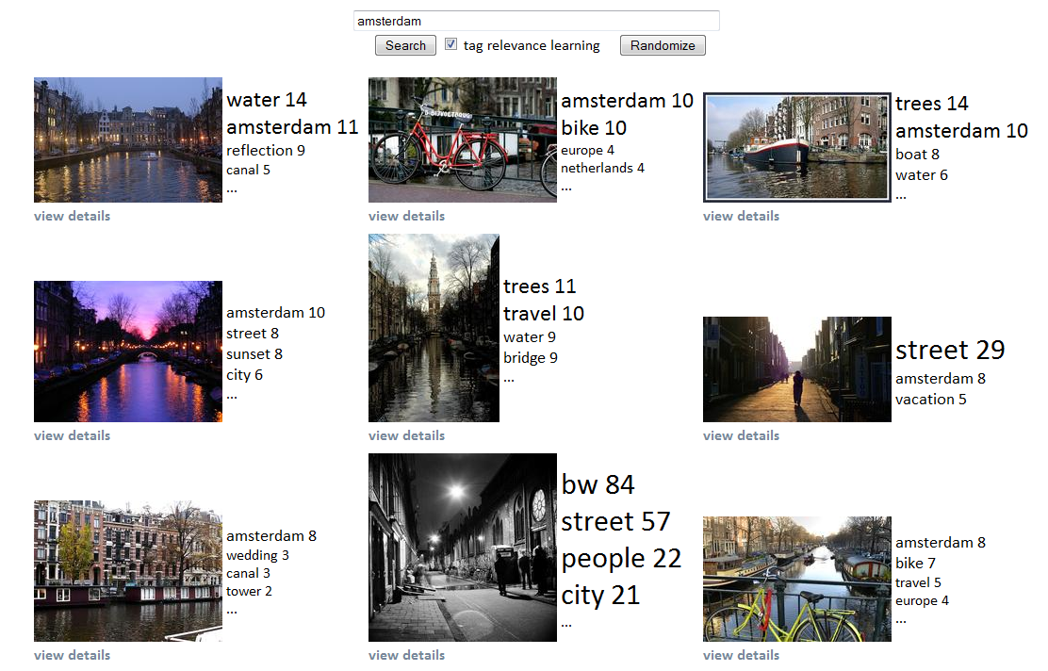
Demo: multi-feature tag relevance
Notes:
http://node443.das3.science.uva.nl:10001/

Slide 98
Quiz: what is the downside of multi-feature tag-relevance learning
While the accuracy is significantly improved, the visual diversity in the results is lost to some extent.

Slide 99
Conclusions
We study multi-feature tag relevance learning to conquer the subjective social tagging problem for social image retrieval.
Multi-feature outperforms single-feature for tag relevance learning.
We propose UniformTagger to combine multi-feature tag relevance
  Solid theoretical foundation
  Simple to implement
  NO labeling required at all
  Competitive performance to supervised combination methods

