Slide 1
CS598: Visual Info Retrieval
Lecture X: Interaction with users
Slides from Cees

Slide 2
Outline
Basic user interaction
Thread visualizations
Extreme retrieval
Learning from the user
Benchmarking the interface gap

Slide 3

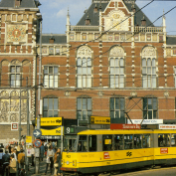
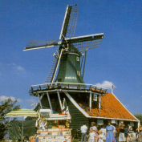



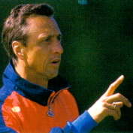
Use is open-ended
This is the interface gap
scope
screen
keywords

Slide 4
So many choices for retrieval…
Why not let user decide interactively?
  Navigate through query methods
  Visualize video retrieval results
  Learn from browsing behavior

Slide 5
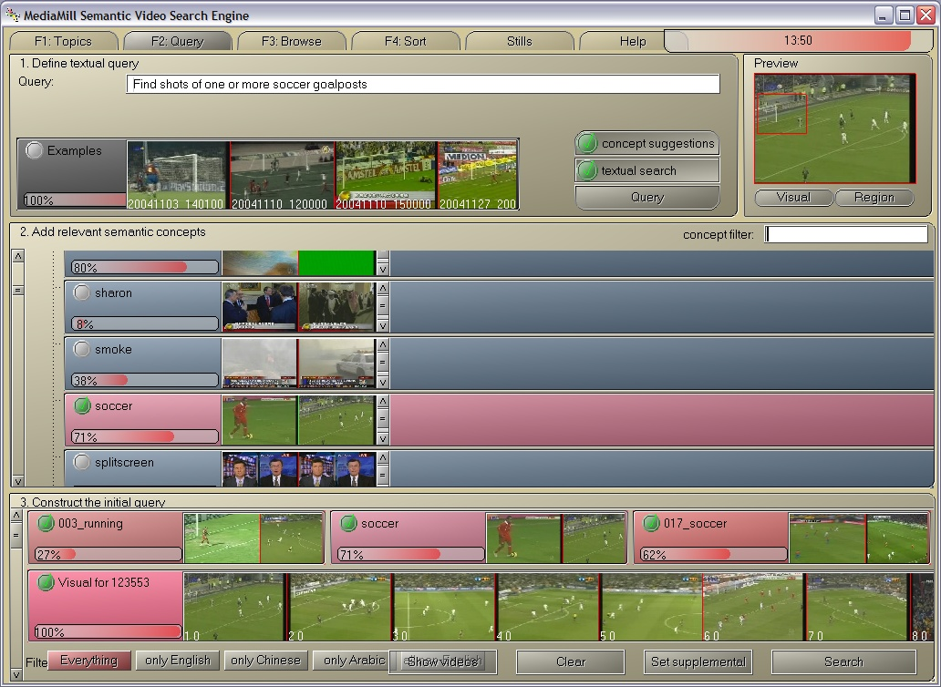
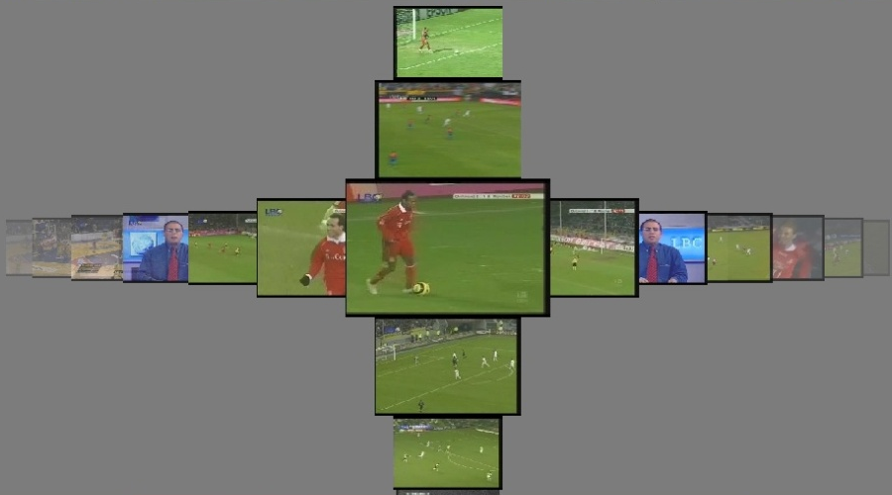
Problem statement
Slide credit: Ork de Rooij
Query by keyword
Query by
region
selection
Automated
Concept
suggestion
Query by example
Query by concept
Leads to
RANKING
Browse
Query component ‘mixer’
Language filter
… and search

Slide 6
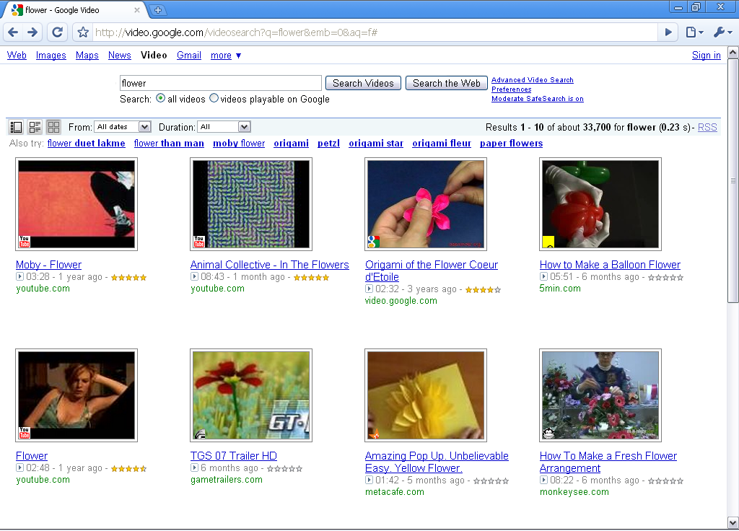
Video search 1.0
Note the influence of textual meta data, such as the video title, on the search results.
X

Slide 7
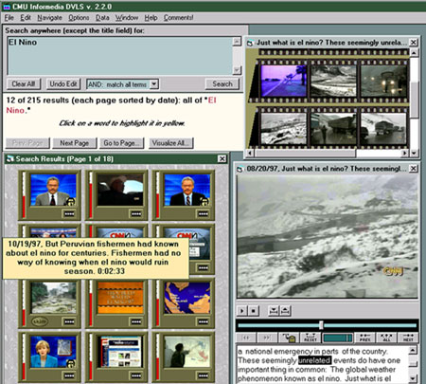
‘Classic’ Informedia system
Carnegie Mellon University
First multimodal video search engine

Slide 8
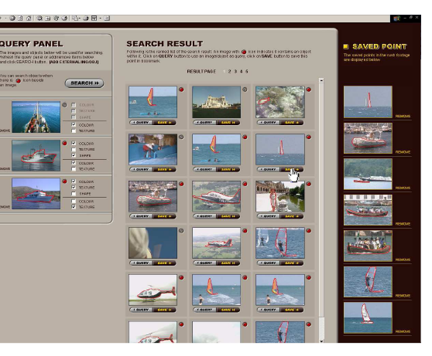
Físchlár
Dublin City University
Optimized for use by “real” users

Slide 9
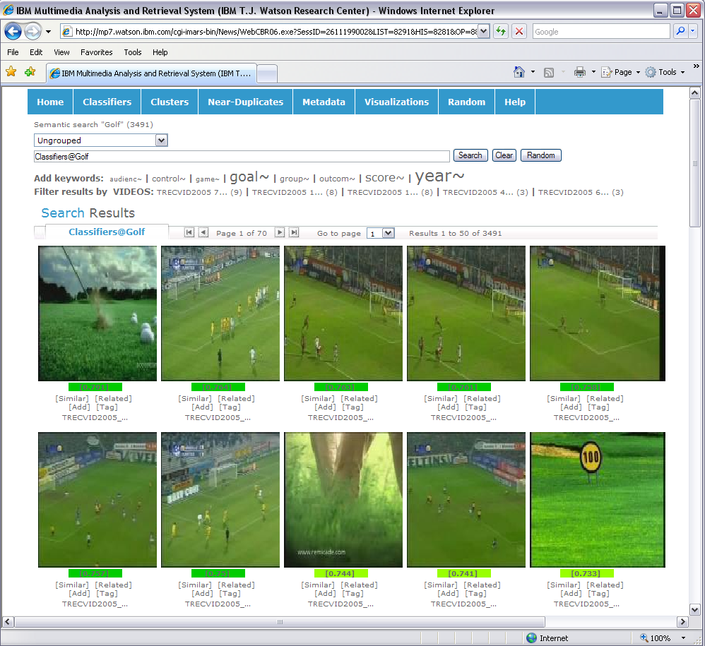
Demo: IBM iMARS
IBM Research
A web based system
http://mp7.watson.ibm.com/

Slide 10
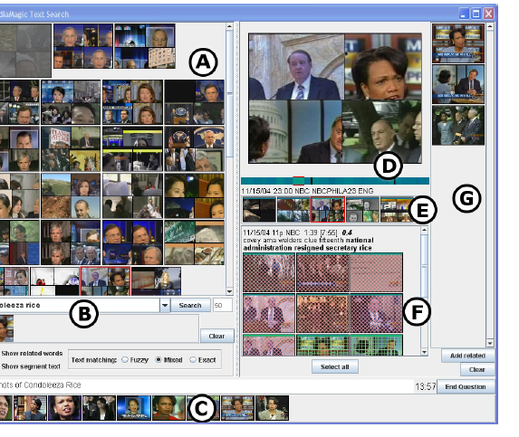
MediaMagic
FxPal
Focus on the story level

Slide 11
Outline
Basic user interaction
Thread visualizations
Extreme retrieval
Learning from the user
Benchmarking the interface gap

Slide 12
Why do we search?
Targeted search
  We want to find something specific quickly
Versus
Exploratory search
  We want to know what is inside the dataset

Slide 13
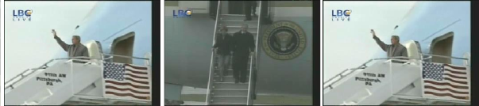
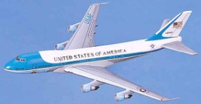
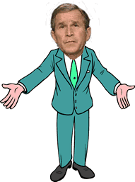

Video threads
de Rooij, TMM 2009
visually similar to…
semantically similar to
visual thread
textual thread
time
semantic thread
initial query
local context
language
timeline
channel
video information space
User query

Slide 14
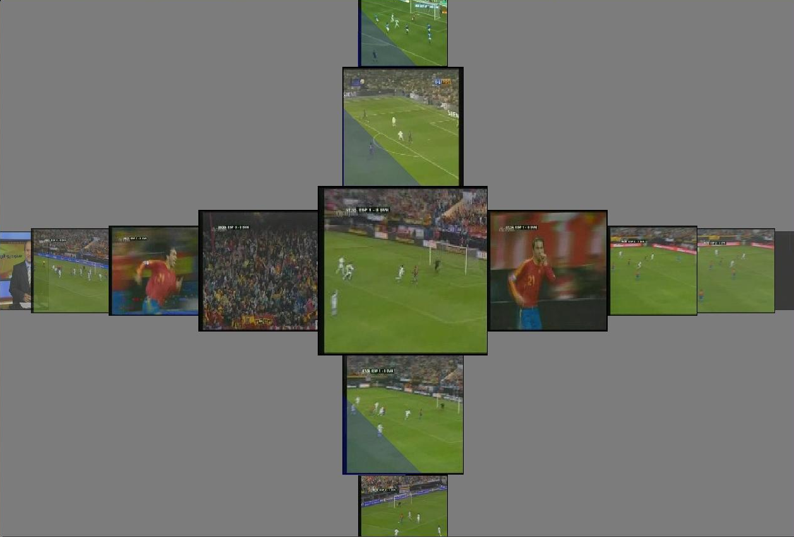
Targeted search: CrossBrowser
Snoek, TMM 2007
Combination of query results and time
Easy to understand
Time axis is important
Very fast browsing
time
ranked results

Slide 15
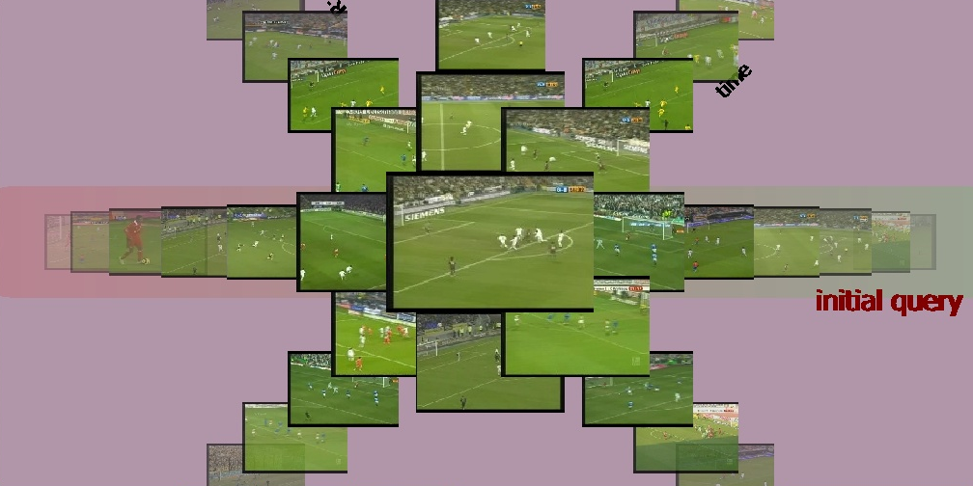
Exploratory search: RotorBrowser
de Rooij, TMM 2009
Query on demand combinations
Dataset exploration
Browsing beyond query
Query only once
time
ranked results from query

Slide 16
An overview
?

Slide 17
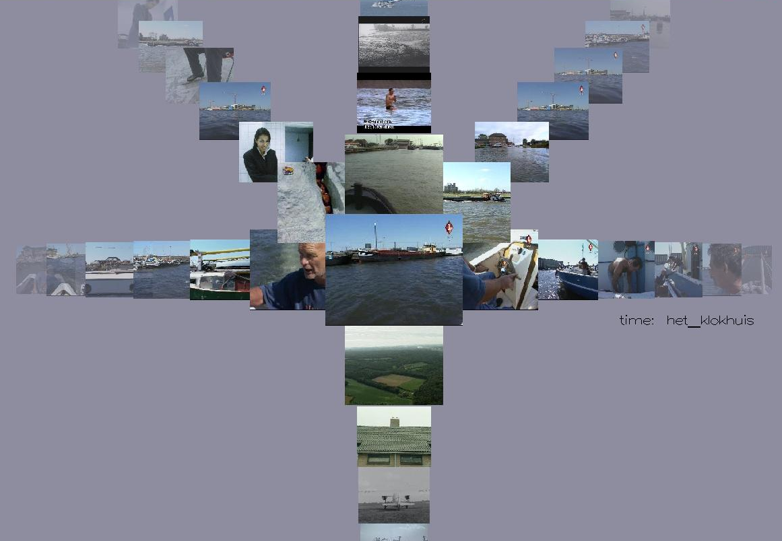
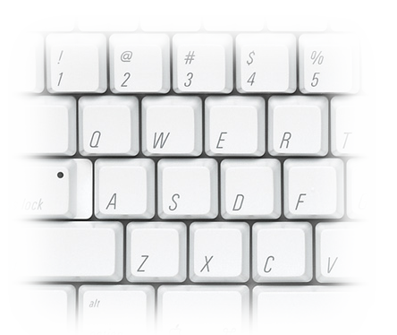
The ForkBrowser
de Rooij, CIVR 2008
results
any thread
any thread
time
“The interface
  indicates to the user where she can go.”
  doesn’t overwhelm the user.”
  avoids switching back to query interface.”
  has a clear mapping between navigation and visualization.”
  Allows the user to browse within shots”
history

Slide 18
The ForkBrowser

Slide 19
User interaction effectiveness
ForkBrowser
CrossBrowser
Clear difference
# of interactions

Slide 20
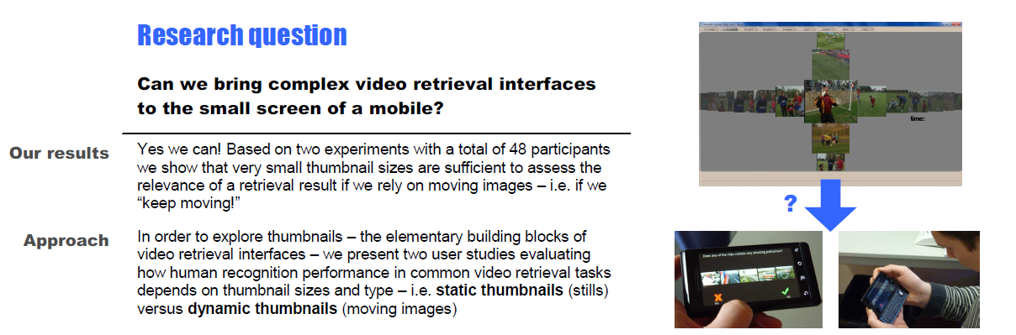
Mobile video retrieval
Hürst et al. ACM MM 2010

Slide 21
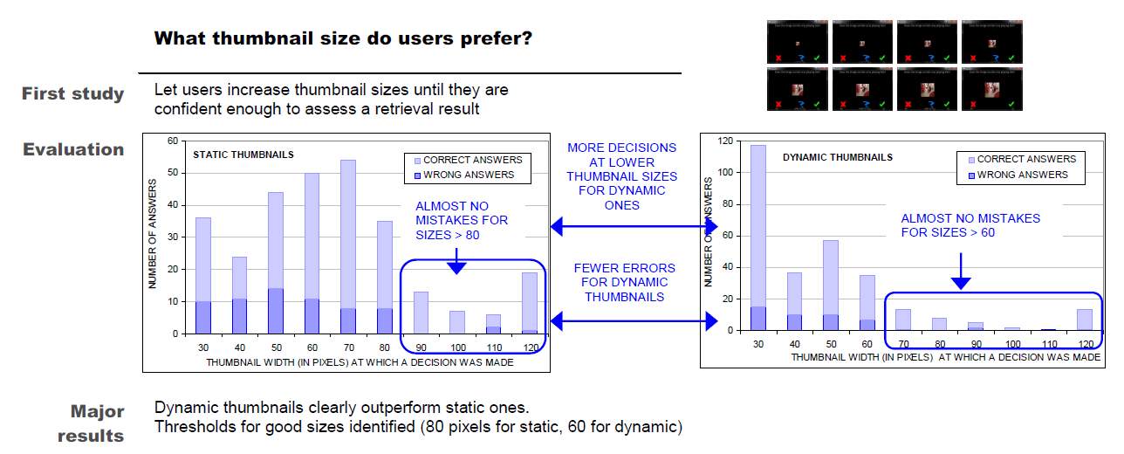
What thumbnail size users prefer?
Hürst et al. ACM MM 2010

Slide 22
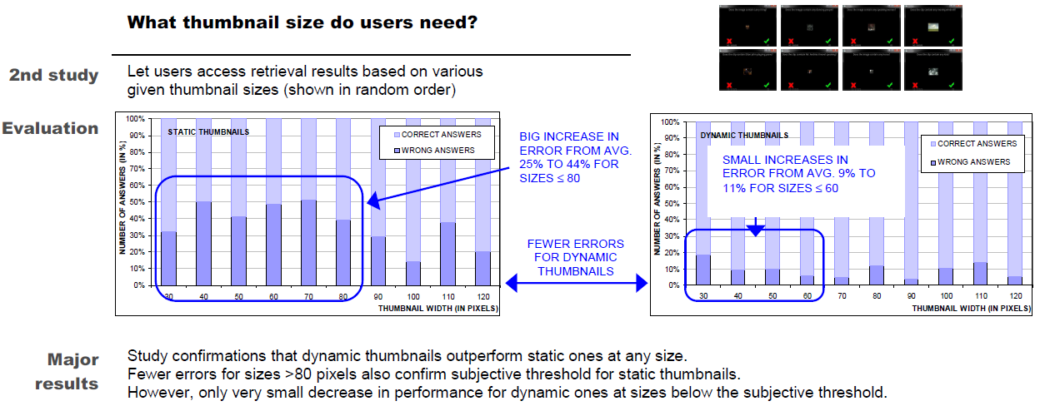
What thumbnail size users need?
Hürst et al. ACM MM 2010

Slide 23
Outline
Basic user interaction
Thread visualizations
Extreme retrieval
Learning from the user
Benchmarking the interface gap

Slide 24
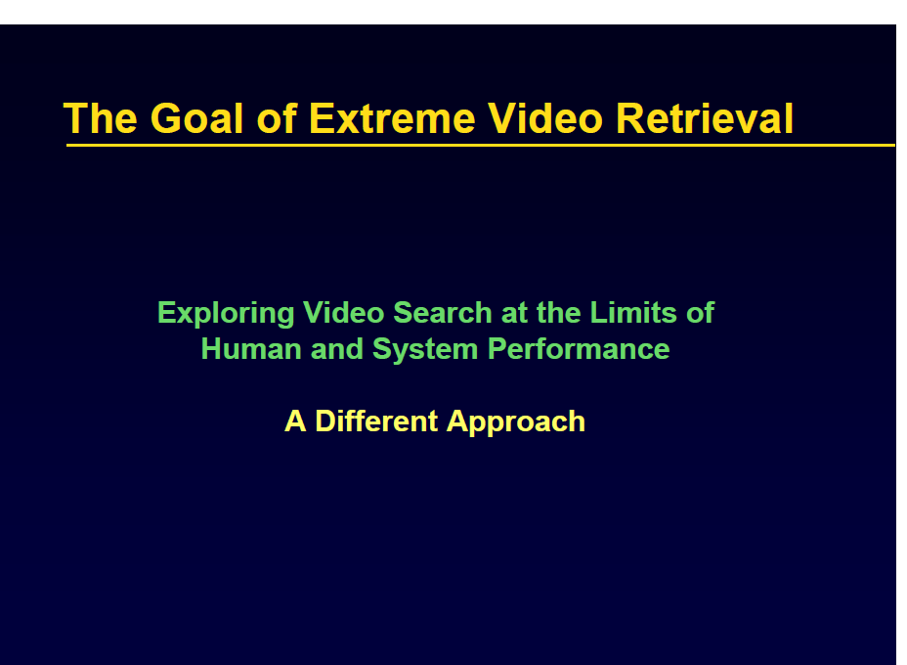
Slides credit: Alex Hauptmann

Slide 25
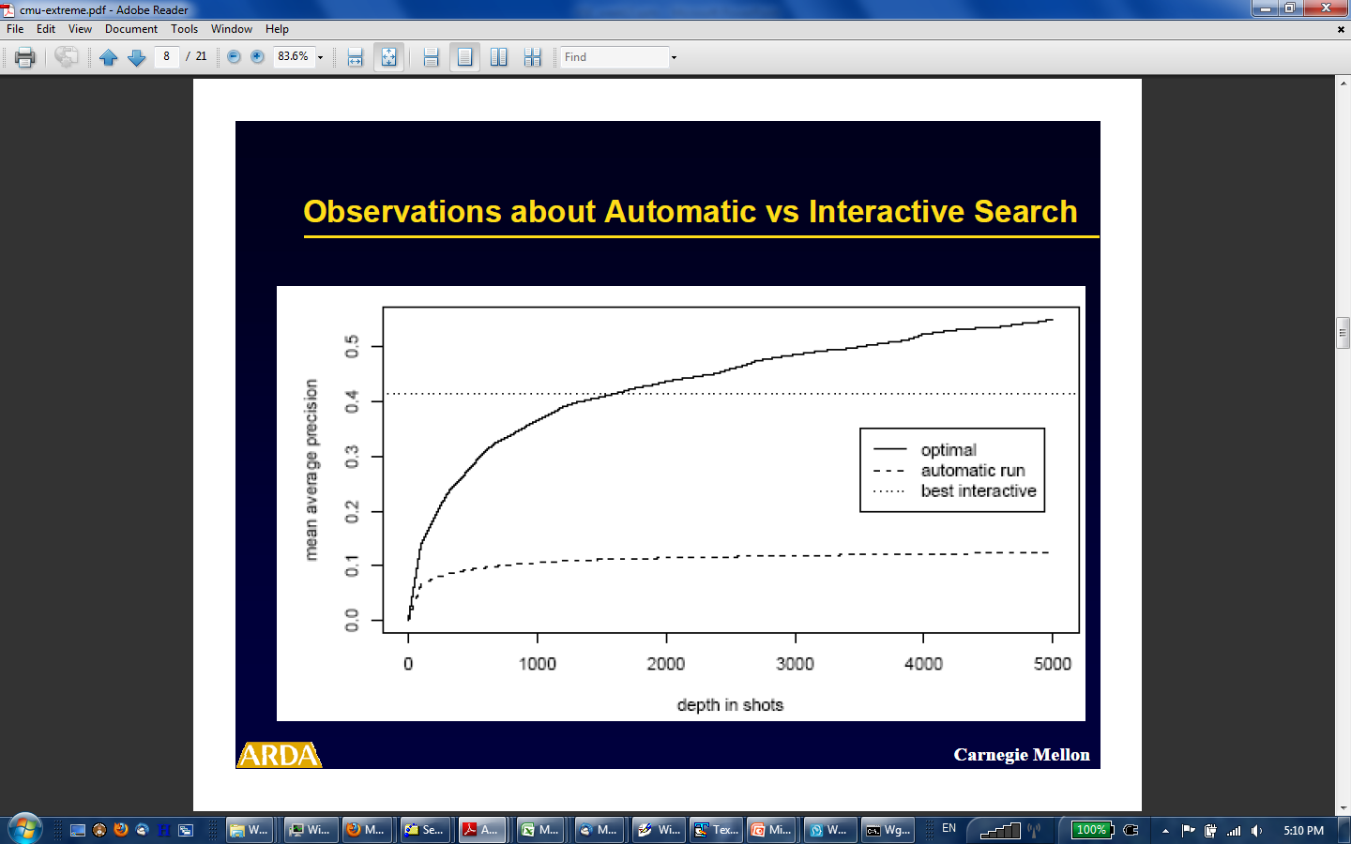

Slide 26
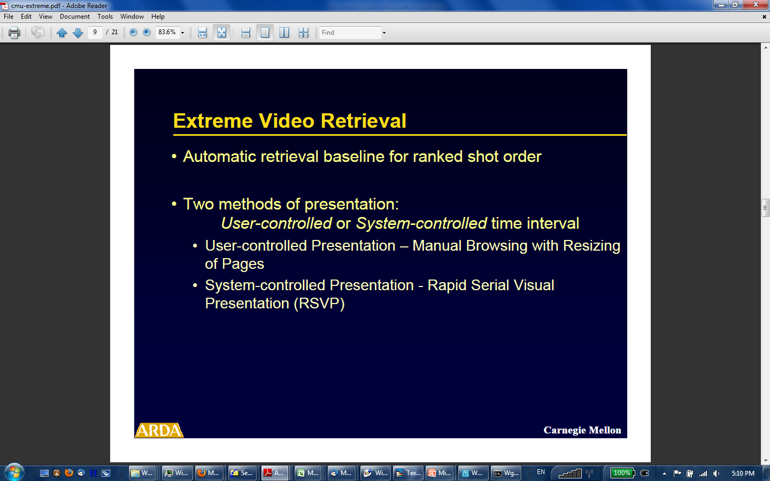

Slide 27
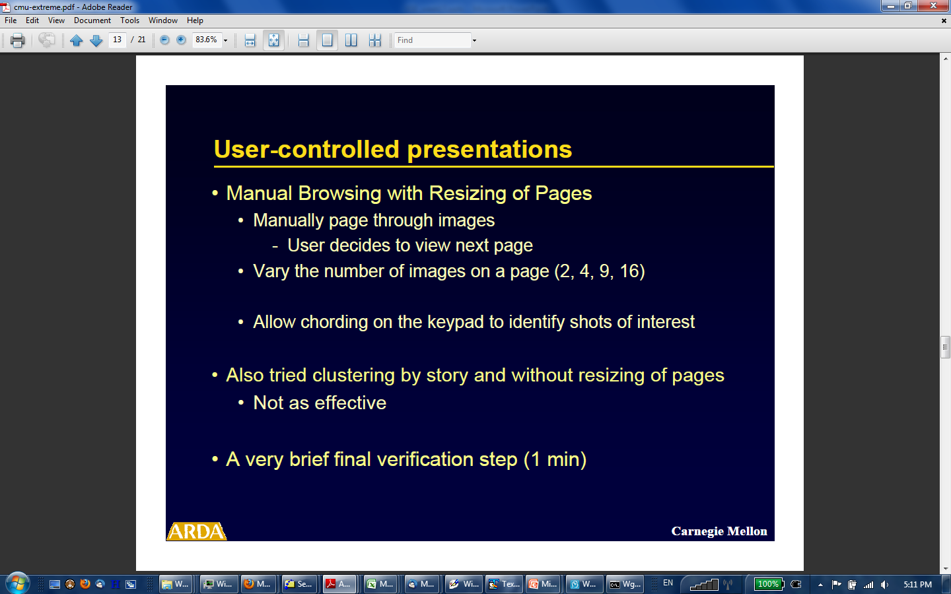

Slide 28
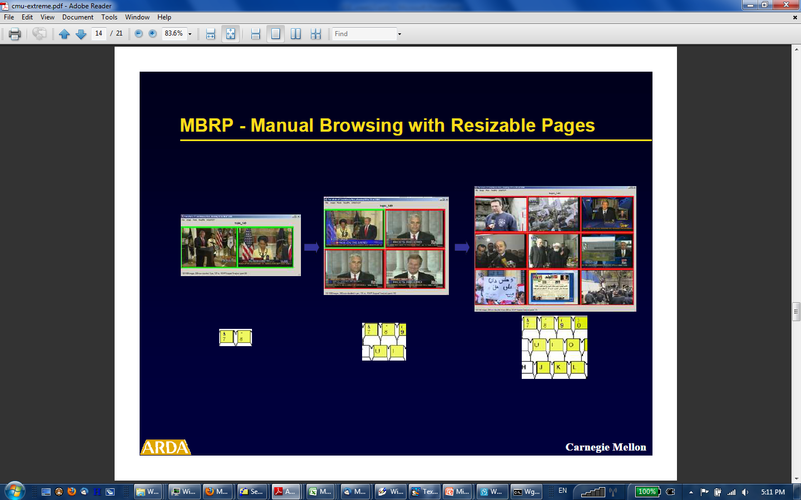

Slide 29
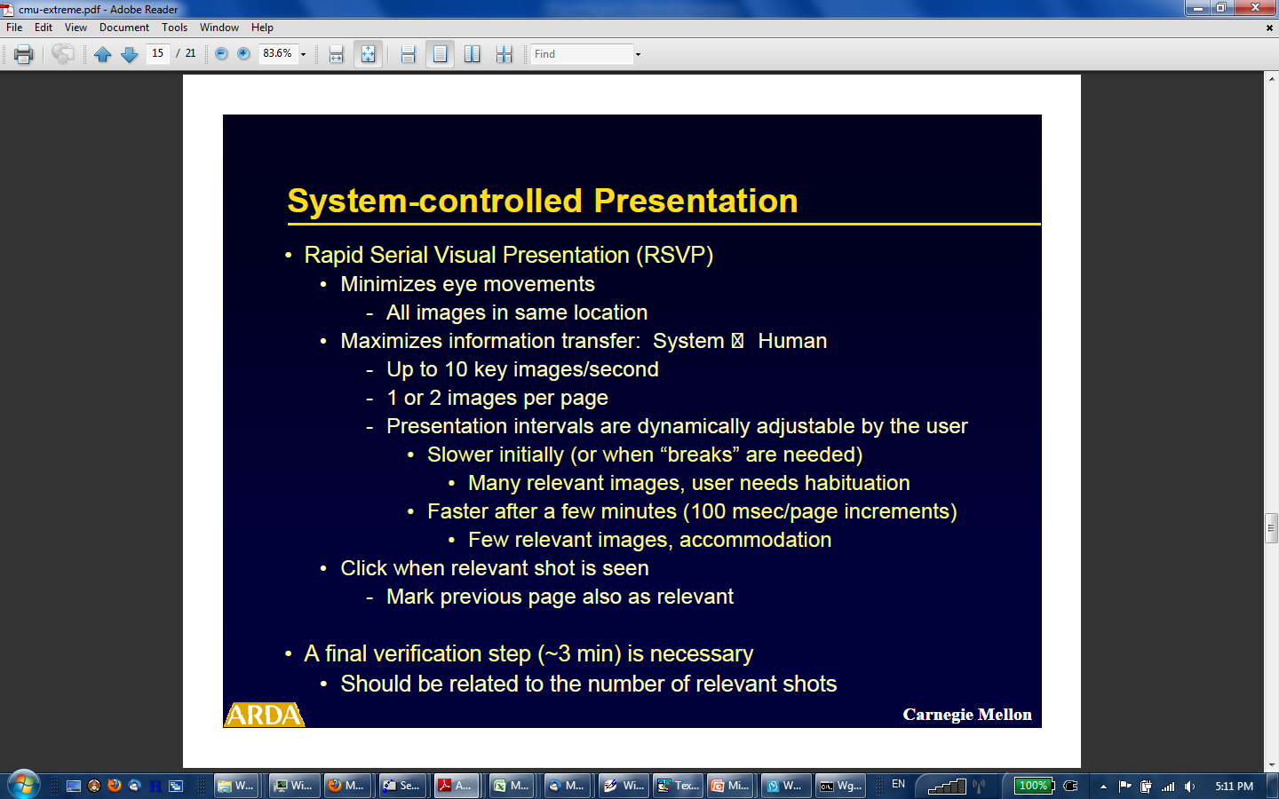

Slide 30
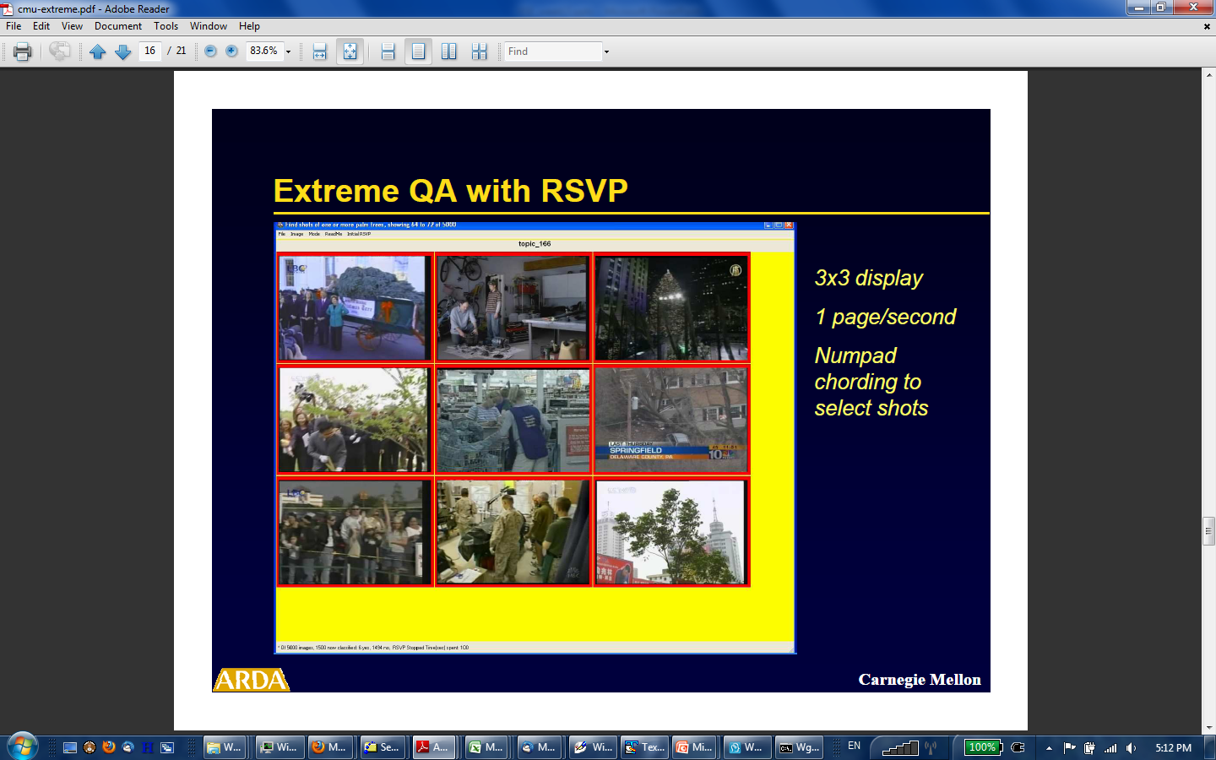

Slide 31
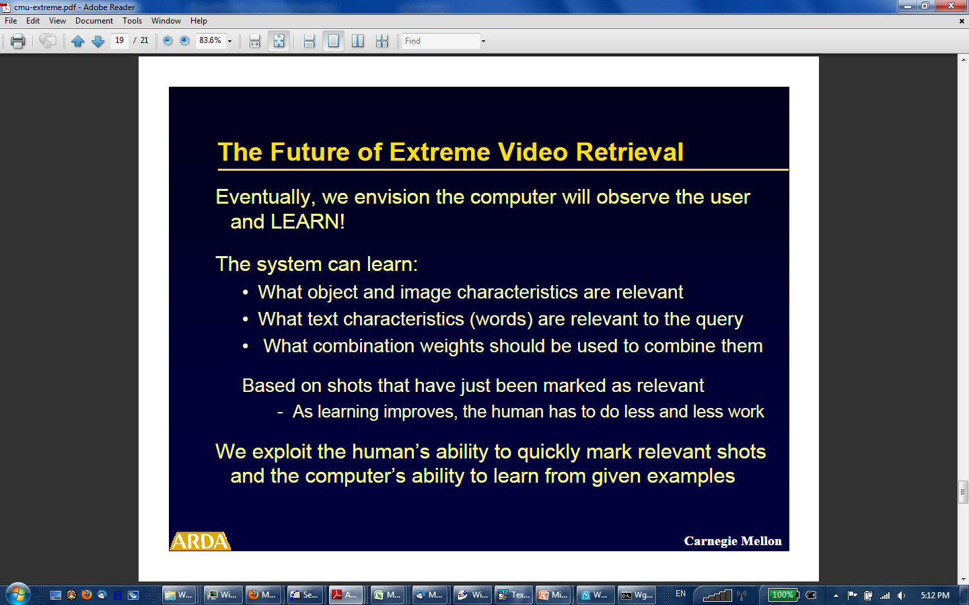

Slide 32
Outline
Basic user interaction
Thread visualizations
Extreme retrieval
Learning from the user
Benchmarking the interface gap

Slide 33
Learning from the user
Two common approaches
  Relevance feedback
  Active learning

Slide 34



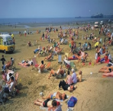


Relevance feedback
Slide credit: Marcel Worring
Try to find boundary in feature space best separating positive
from negative examples
F₁
In the next iteration the user will have more samples hence a better estimate of the boundary
F
F
2
Measure of class membership probability

Slide 35
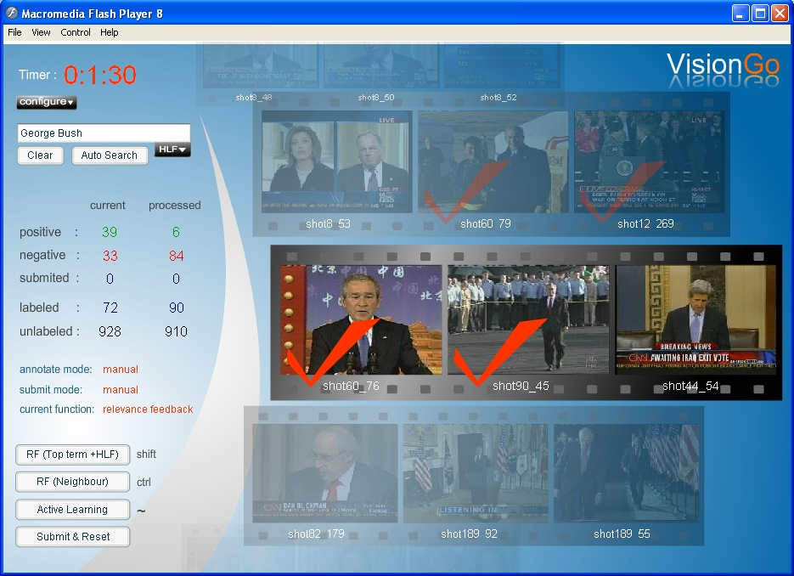
VisionGo
NUS & ICT-CAS
Extremely fast and efficient

Slide 36




Active learning
Slide credit: Marcel Worring
The system can safely assume
this sample is also negative
F₁
In active learning the system decides which elements to show for feedback and which not.
For the system it is
relevant to know this label
F
F
2

Slide 37
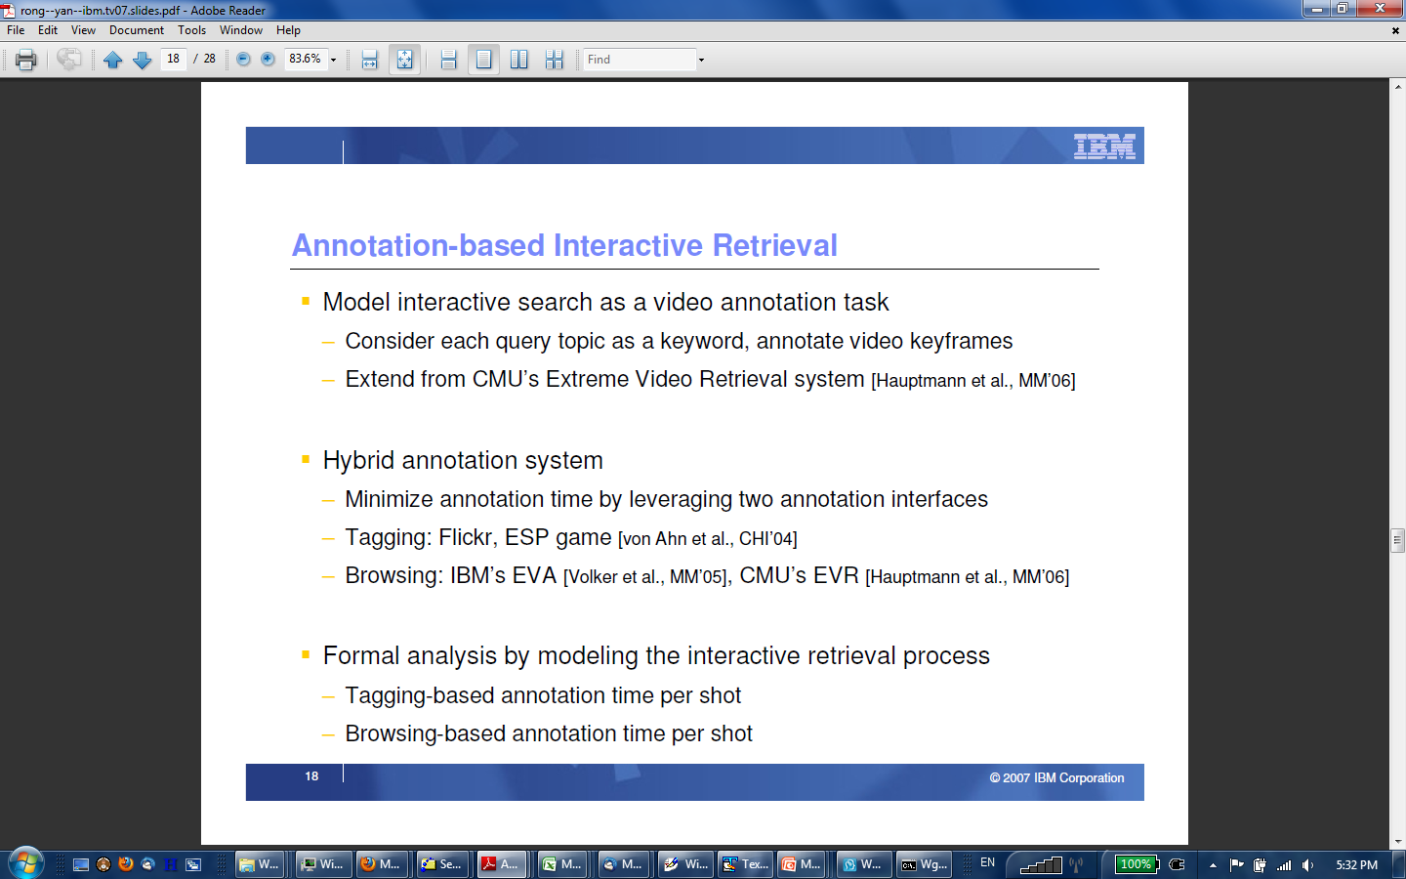

Slide 38
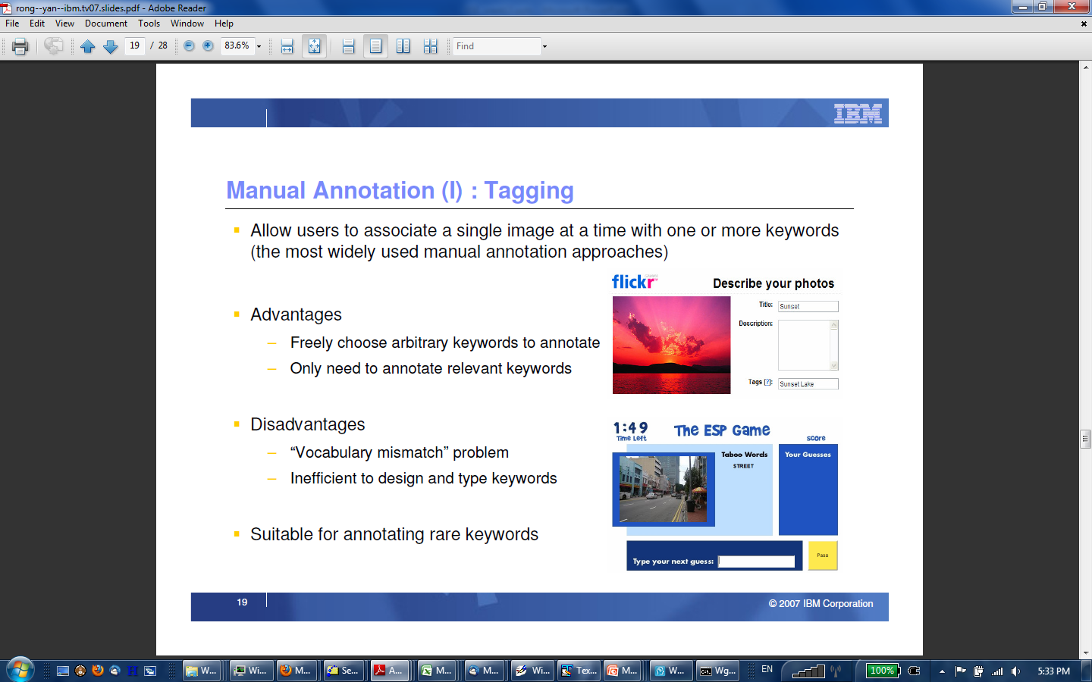

Slide 39
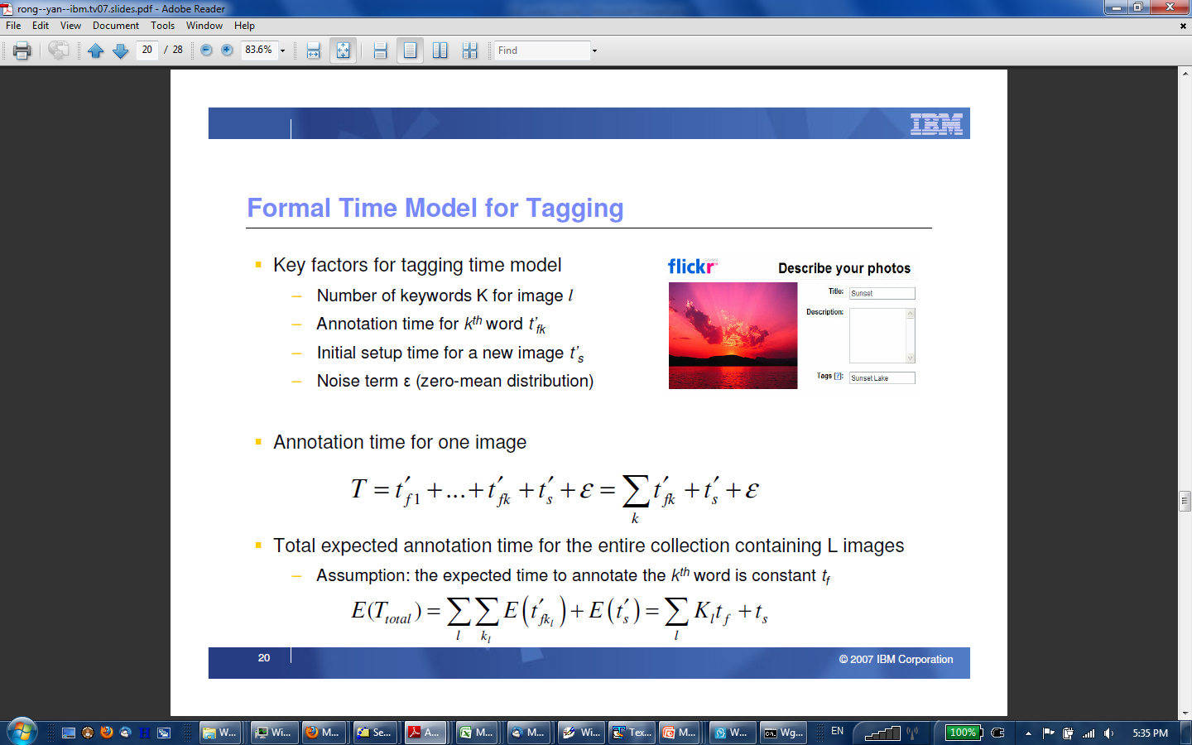

Slide 40
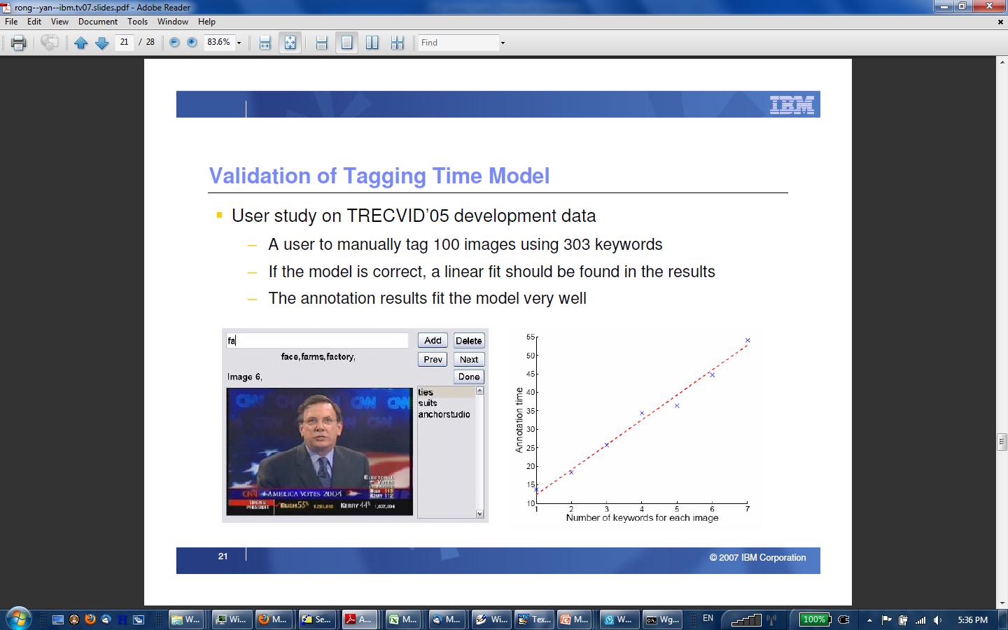

Slide 41
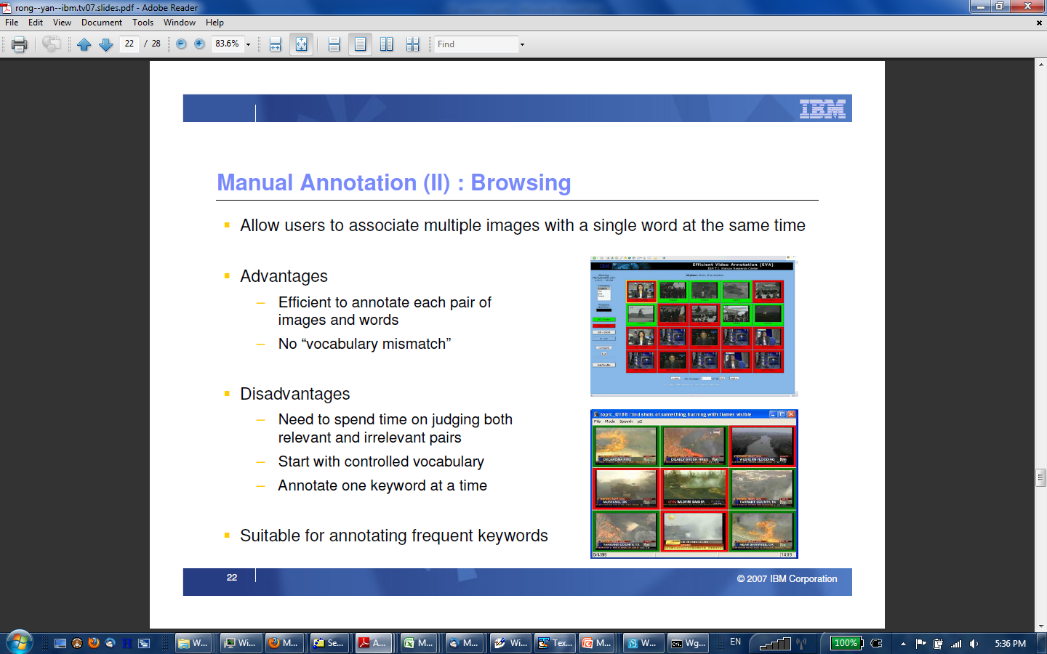

Slide 42
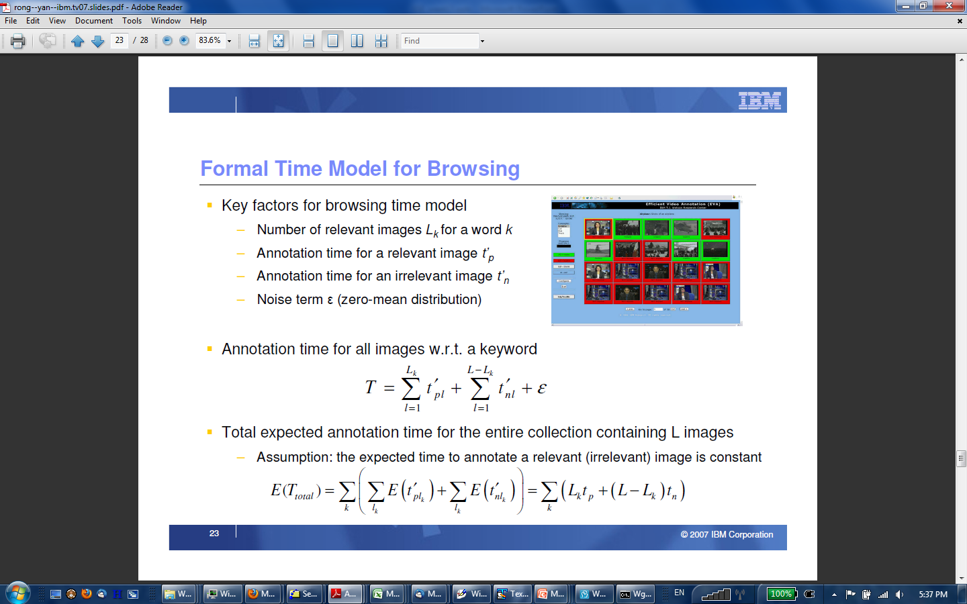

Slide 43
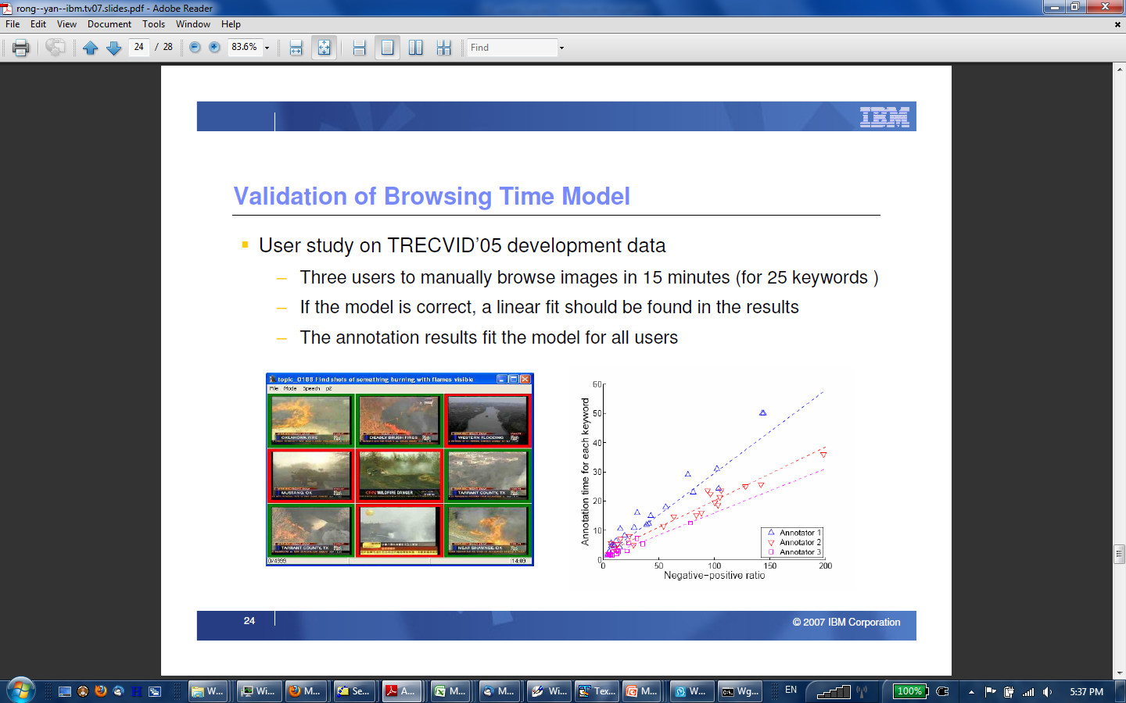

Slide 44
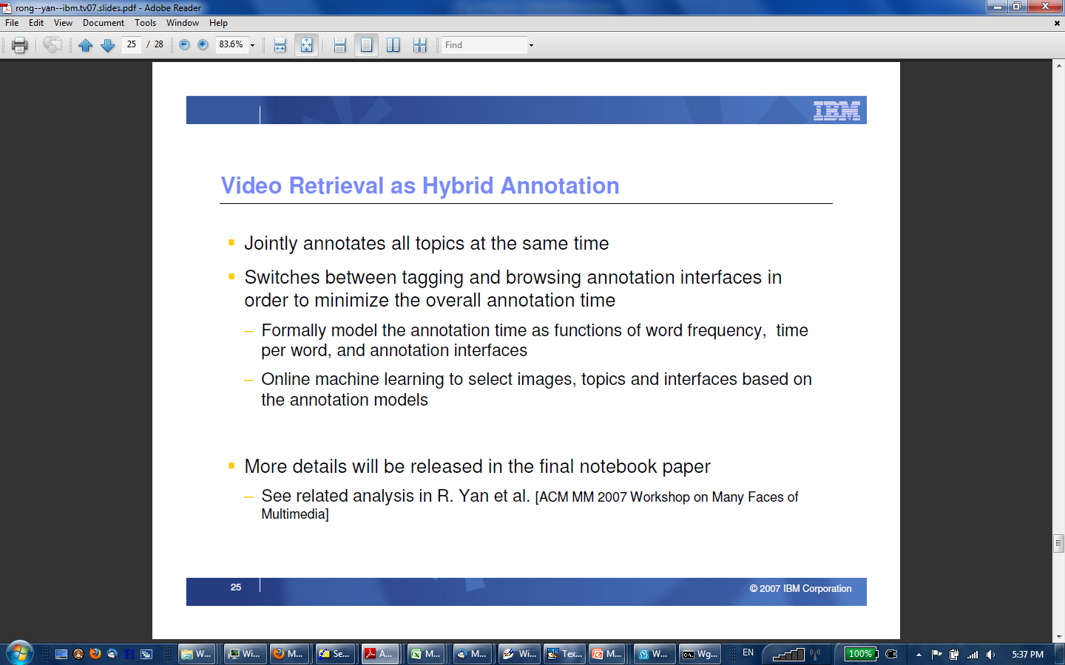

Slide 45
Video for the masses
Crowdsourcing mechanism
  rely on online users to improve, extend, and share, automatically detected results in video fragments

Slide 46
Case study: Pinkpop
Festival TV broadcasts from 1970-2010
Copyright cleared for major Dutch bands
Includes raw, unpublished footage

Slide 47
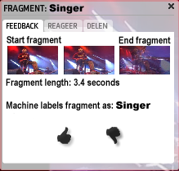
Encouraging user feedback
Snoek et al. ACM MM 2010
Correct labels
Add new labels
Adapt fragment boundaries

Slide 48
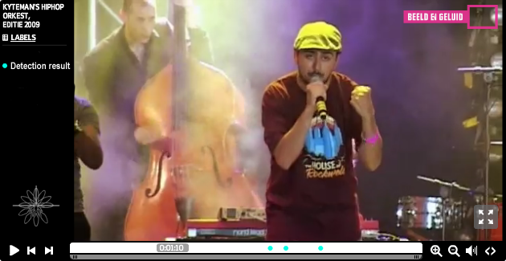
Simple timeline-based browser
Snoek et al. ACM MM 2010
Video timeline
Automatic ‘tag’
Notes:
Watch and navigate a single concert
Colored dots mark detected fragments
Comment on individual fragments
Share fragment on Twitter
Embed player on different websites

Slide 49
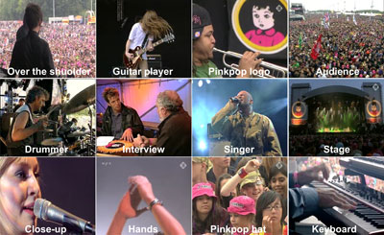
Concert concepts
Snoek et al. ACM MM 2010

Slide 50
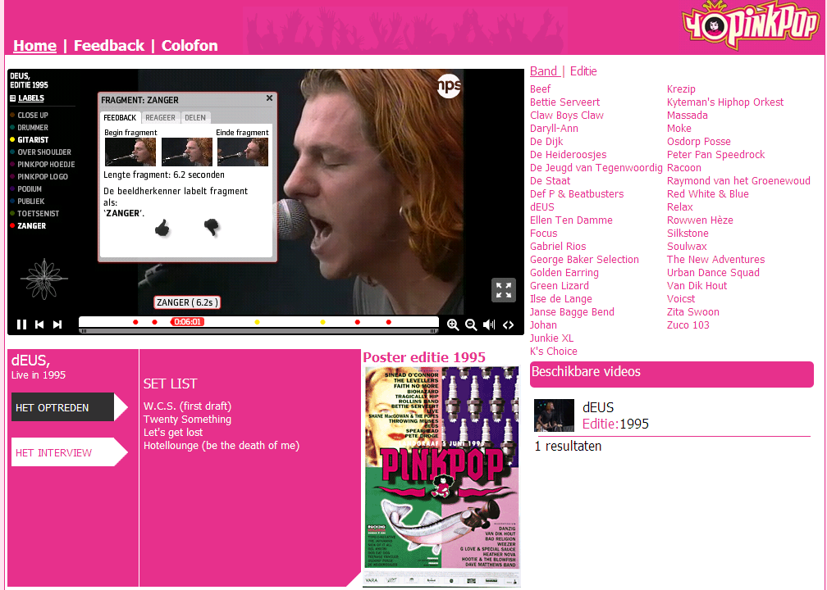



Crowdsourcing video retrieval
http://hollandsglorieoppinkpop.nl/

Slide 51
Outline
Basic user interaction
Thread visualizations
Extreme retrieval
Learning from the user
Benchmarking the interface gap

Slide 52
Interface gap best addressed by
TRECVID interactive search task
  Interactively solve 20+ search topics (10/15 minutes)
  Return 1,000 ranked shot-based results per topic
  Evaluate using Average Precision
VideOlympics showcase
Notes:
Evaluate human factor in video retrieval

Slide 53


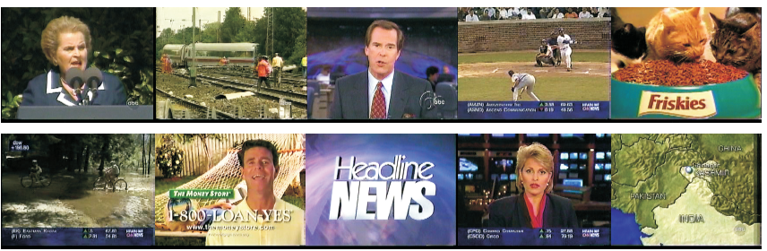


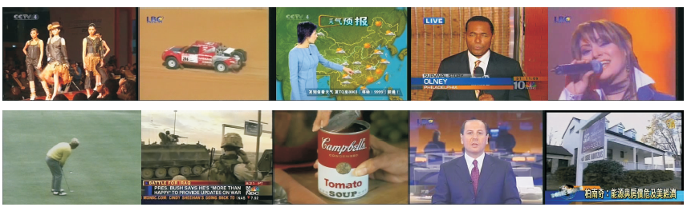


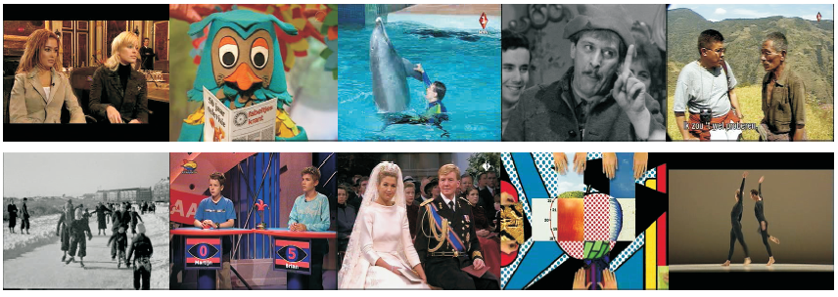
Recap: Video data sets
US TV news (`03/`04)
International TV news (`05/`06)
Dutch TV infotainment (`07/`08/`09)

Slide 54
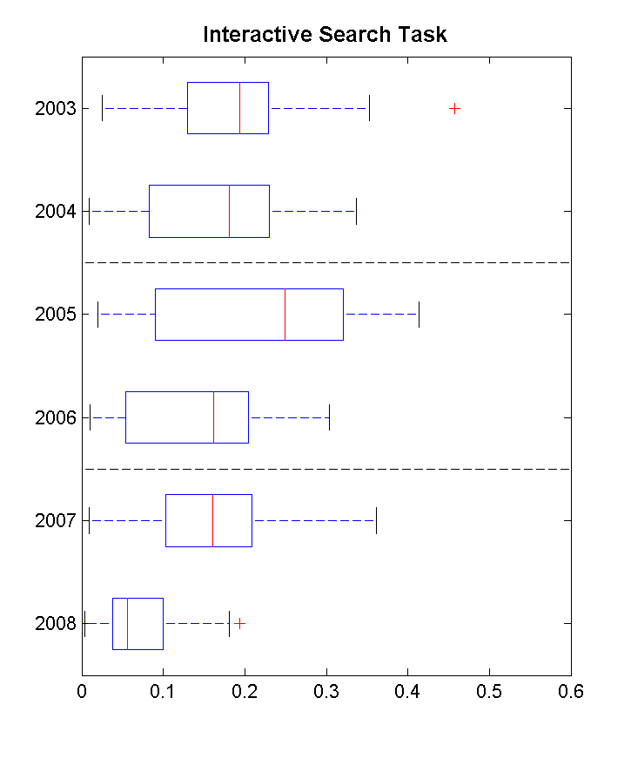
Video browsing at TRECVID
Wide performance variation
  # concept detectors
  Search interface
  Expert vs novice user
Most pronounced
  2003: Informedia classic
  2005: Large semantic lexicon
  2008: Active learning
Edition
Mean Average Precision

Slide 55
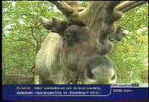
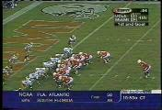
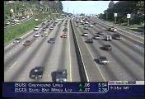
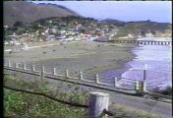




























Annotated 32 concept lexicon
TRECVID 2004
Animal
Footbal
Road
Beach
Stock Quotes
Golf
Financial Anchor
Cartoon
Building
Airplane
Take Off
Boat
Graphic
People
Car
Vegetation
Overlayed Text
Basket
Scored
Bill Clinton
Sporting Event
Studio Setting
Physical Violence
Train
Baseball
News Subject Monologue
Anchor
Outdoor
Ice Hockey
People Walking
Madeleine Albright
Soccer
Bicycle
Weather News
Notes:
55

Slide 56











Experiment 1
TRECVID 2004
Lexicon = 32 concepts
nothing really works
The Good
indirectly in lexicon
very specific
not in lexicon
directly in lexicon
(in)directly in lexicon
not in
lexicon: LSI
The Bad
indirectly in lexicon
not in lexicon
directly in lexicon
Query-by-example
The Ugly
not in lexicon
directly in lexicon
indirectly in lexicon
exploit TV repetition
56
Notes:
56

Slide 57

Annotated 101 concept lexicon
TRECVID 2005

Slide 58







Experiment 2
TRECVID 2005
Lexicon = 101 concepts
not in lexicon
poor concept detection
The Good
Almost all topics solvable
by using concept lexicon only!
concept specification fails
The Bad
concept combination fails
The Beautiful
Exploit common sense!
58
Notes:
58

Slide 59




UvA-MediaMill browsers@TRECVID
Snoek et al. TRECVID 04-09
CrossBrowser
ForkBrowser
Traditional systems
  • 228 other interactive systems
Notes:
59

Slide 60

Criticism
Retrieval performance cannot be the only evaluation criterion
  Quality of detectors counts
  Experience of searcher counts
  Visualization of interface counts
  Ease of use counts
  …

Slide 61


Video browsing at VideOlympics
Promote multiple facets of video search
  Real-time interactive video search ‘competition’
  Simultaneous exposure of multiple video search engines
  Highlight possibilities and limitations of state-of-the-art

Slide 62














Participants

Slide 63

The future of video retrieval?
Jonathan Wang, Carnegie Mellon University

Slide 64

Video trailer
http://www.VideOlympics.org
Notes:
64

Slide 65
Conclusion on video browsing
Interaction by browsing indispensible for any practical video search engine
System should support user by active learning and intuitive (mobile) visualizations

Slide 66
Conclusion

Slide 67
Visual Search Engines
Conclusion on:
query
prediction
concept
detection
lexicon
learning
measuring
features
image/video
browsing
images
image/video

Slide 68

Next week
You will be presenting your final
Project paper deadline: Monday, May 5th
Notes:
Mention summary

Slide 69


Your feedback is appreciated
TOP
  Please indicate one item of the lecture you liked
FLOP
  Please indicate one item that should be improved

Slide 70
Q
A
&

