Slide 1
CS598 Visual Information Retrieval
Lecture VI: Spatiotemporal Visual Representation

Slide 2
Lecture VII
Part I: Action Recognition
Slides credit: James Hays

Slide 3

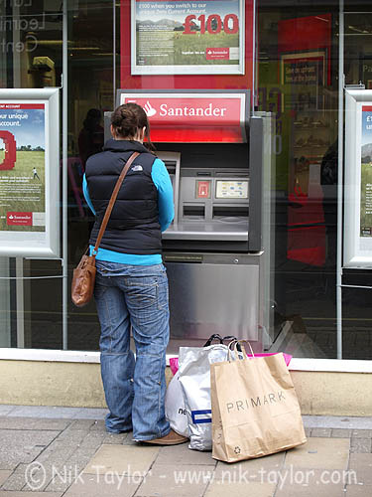
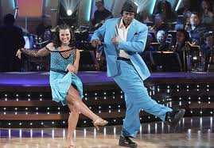
What is an action?
Action: a transition from one state to another
Who is the actor?
How is the state of the actor changing?
What (if anything) is being acted on?
How is that thing changing?
What is the purpose of the action (if any)?

Slide 4
Human activity in video
No universal terminology, but approximately:
“Actions”: atomic motion patterns -- often gesture-like, single clear-cut trajectory, single nameable behavior (e.g., sit, wave arms)
“Activity”: series or composition of actions (e.g., interactions between people)
“Event”: combination of activities or actions (e.g., a football game, a traffic accident)
Adapted from Venu Govindaraju

Slide 5
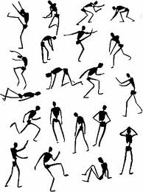
How do we represent actions?
Categories
  Walking, hammering, dancing, skiing, sitting down, standing up, jumping
Poses
Nouns and Predicates
<man, swings, hammer>
<man, hits, nail, w/ hammer>

Slide 6
What is the purpose of action recognition?

Slide 7
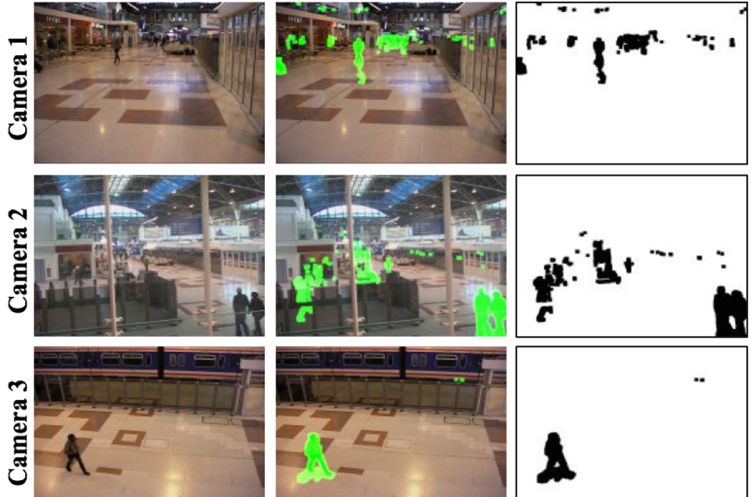
Surveillance
http://users.isr.ist.utl.pt/~etienne/mypubs/Auvinetal06PETS.pdf

Slide 8
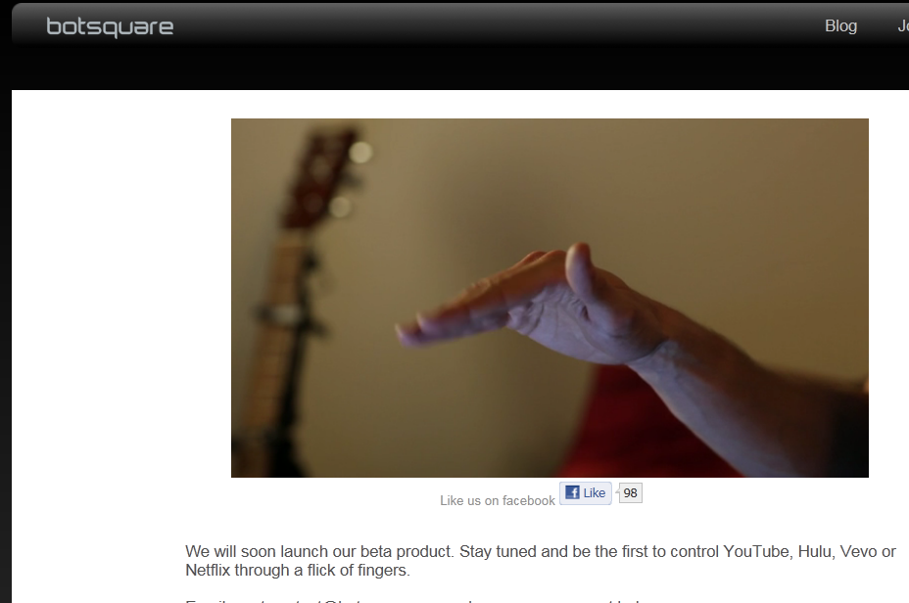
Interfaces
2011

Slide 9
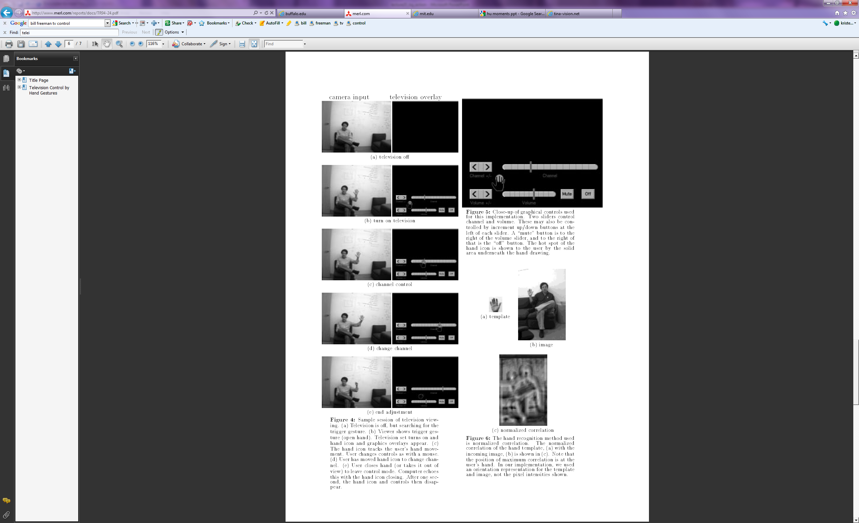
Interfaces
2011
1995
W. T. Freeman and C. Weissman, Television control by hand gestures, International Workshop on Automatic Face- and Gesture- Recognition, IEEE Computer Society, Zurich, Switzerland, June, 1995, pp. 179--183. MERL-TR94-24
Notes:
www.botsquare.com

Slide 10
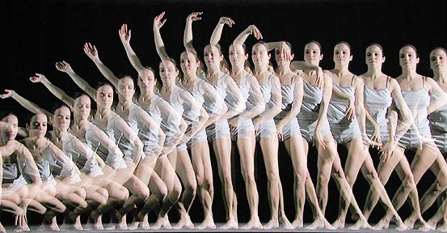


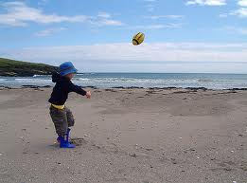
How can we identify actions?
Motion
Pose
Held Objects
Nearby Objects

Slide 11
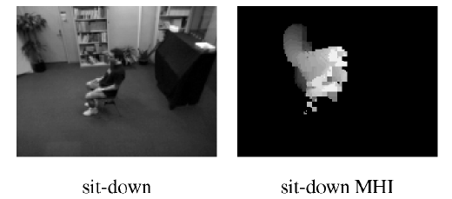
Representing Motion
Optical Flow with Motion History
Bobick Davis 2001
Notes:
Values reflect magnitude and recentness of movements

Slide 12
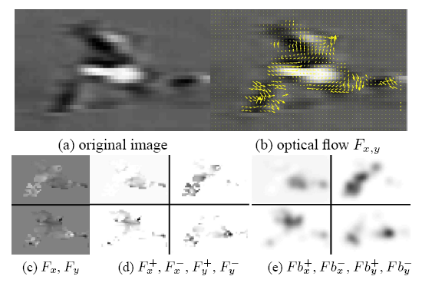
Representing Motion
Optical Flow with Split Channels
Efros et al. 2003

Slide 13
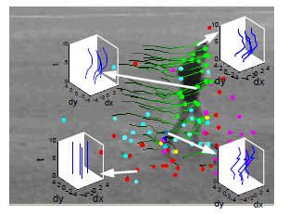
Representing Motion
Tracked Points
Matikainen et al. 2009
Notes:
Point tracks reflect long-term motions

Slide 14
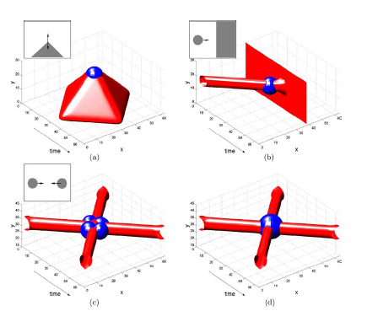
Representing Motion
Space-Time Interest Points
Corner detectors in space-time
Laptev 2005
Notes:
Detect interest points in time and position

Slide 15
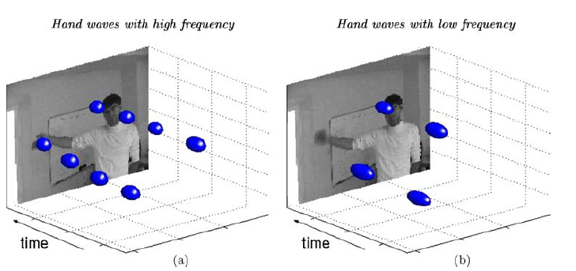
Representing Motion
Space-Time Interest Points
Laptev 2005
Notes:
Detect interest points in time and position

Slide 16
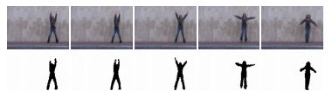
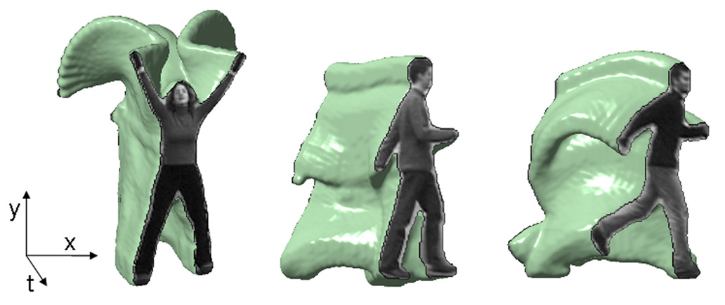
Representing Motion
Space-Time Volumes
Blank et al. 2005

Slide 17
Examples of Action Recognition Systems
Feature-based classification
Recognition using pose and objects

Slide 18
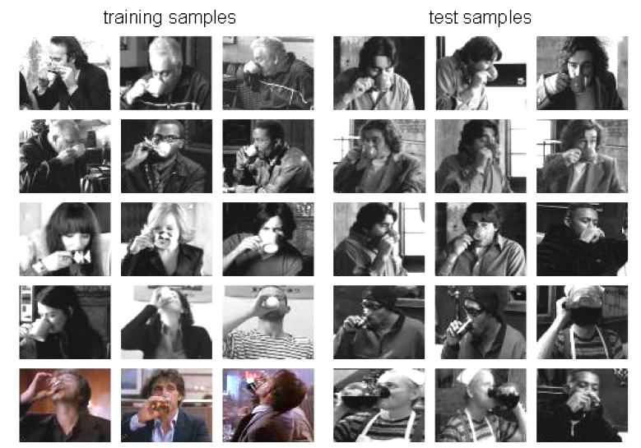
Action recognition as classification
Retrieving actions in movies, Laptev and Perez, 2007

Slide 19




Remember image categorization…
Training
Training Labels
Training Images
Image Features
Classifier Training
Trained Classifier

Slide 20

Remember image categorization…
Training
Training Labels
Training Images
Image Features
Classifier Training
Trained Classifier
Testing
Image Features
Trained Classifier
Prediction
Outdoor
Test Image

Slide 21
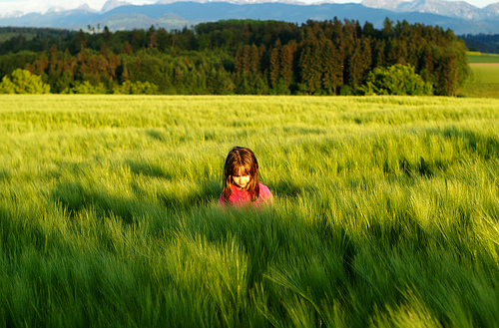
Remember spatial pyramids….
Compute histogram in each spatial bin

Slide 22
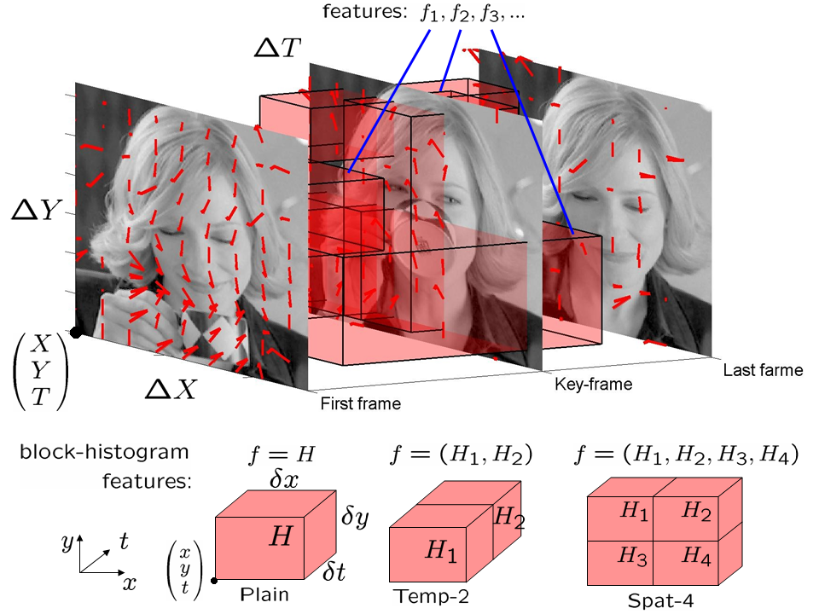
Features for Classifying Actions
Spatio-temporal pyramids (14x14x8 bins)
  Image Gradients
  Optical Flow
Notes:
To investigate the influence of shape information on action
recognition we learn two classifiers, one with optic flow
features only (OF5 classifier) and another one with shape
and motion features (OFGrad9 classifier)

Slide 23
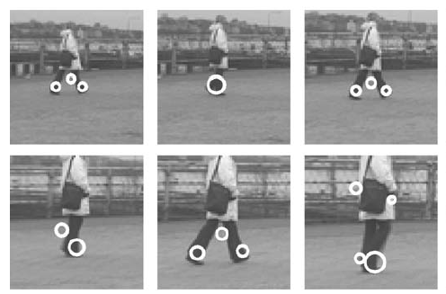
Features for Classifying Actions
Spatio-temporal interest points
Corner detectors in space-time
Descriptors based on Gaussian derivative filters over x, y, time

Slide 24
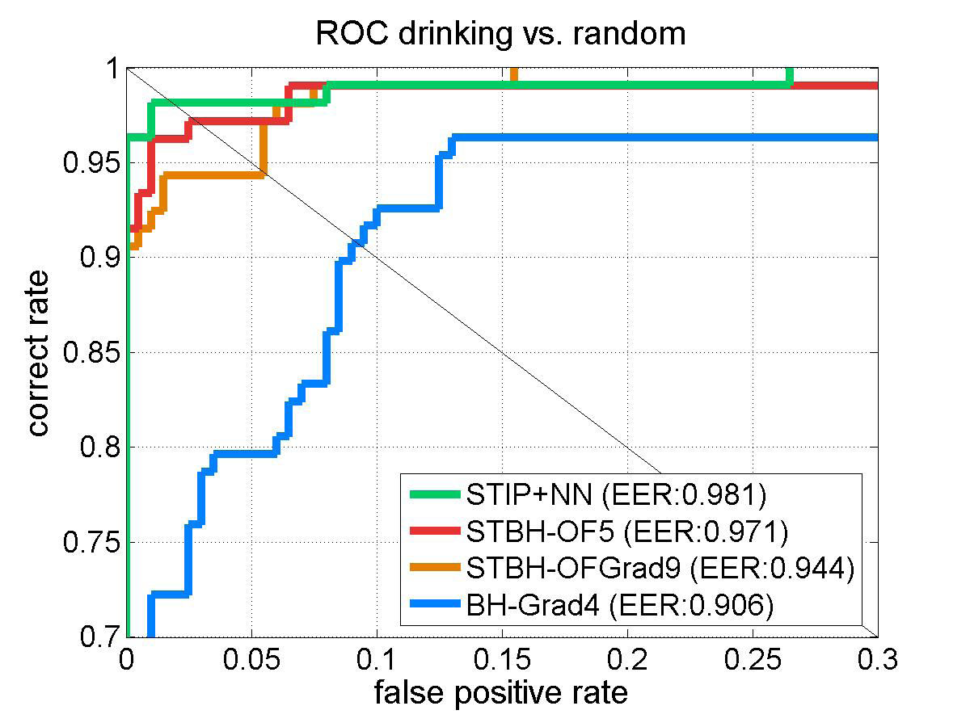
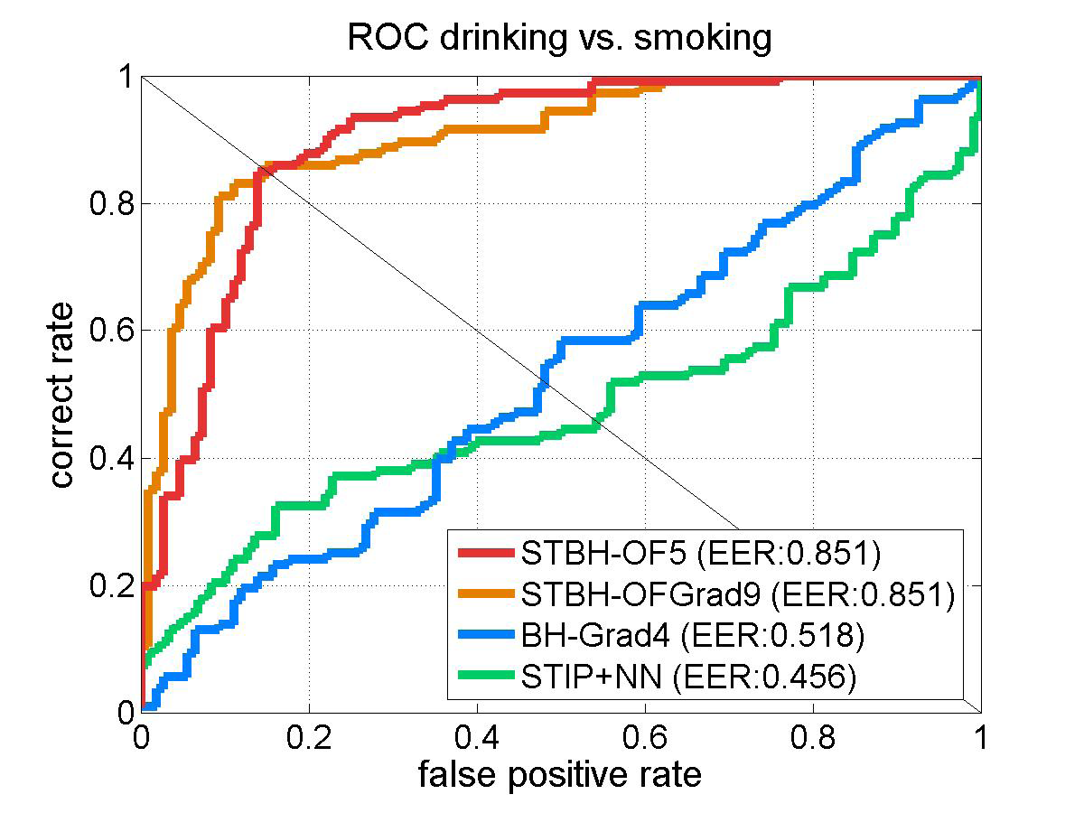
Classification
Boosted stubs for pyramids of optical flow, gradient
Nearest neighbor for STIP
Notes:
Figure 5. Classification of drinking actions vs. (right): smoking actions and (left): random motion patterns. (left) is a magnified part of (b). ROC
curves are obtained by thresholding on the confidence values of test samples. For boosted classifiers the confidence is defined by the
number of passed cascade stages. For STIP-NN classifier the confidence is the normalized distance to the closest negative training sample.

Slide 25
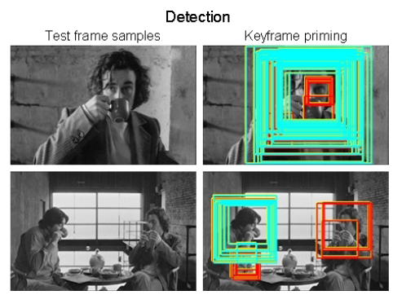
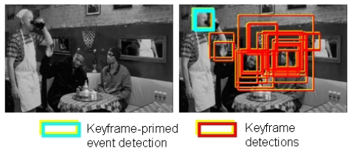
Searching the video for an action
Detect keyframes using a trained HOG detector in each frame
Classify detected keyframes as positive (e.g., “drinking”) or negative (“other”)

Slide 26
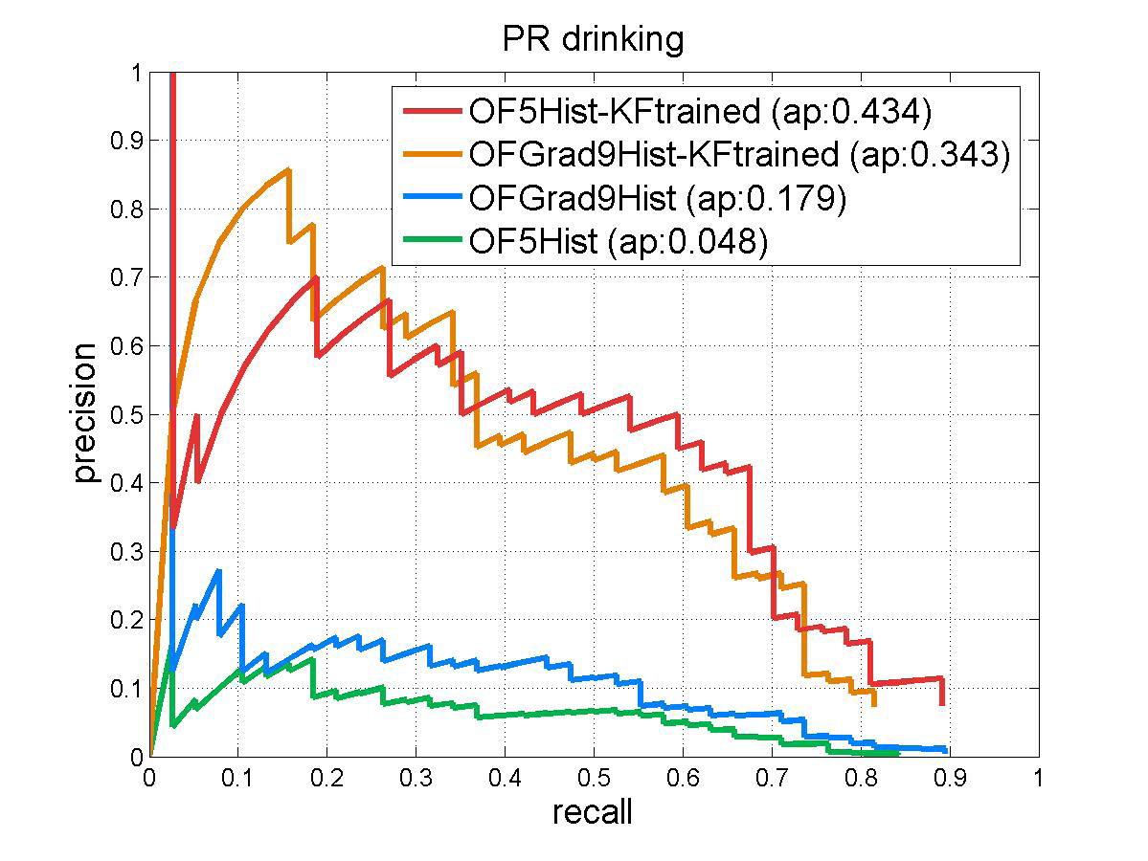
Accuracy in searching video
With keyframe detection
Without keyframe detection
Notes:
Figure 7. Precision-recall curves illustrating the performance of
drinking action detection achieved by the four tested methods.

Slide 27

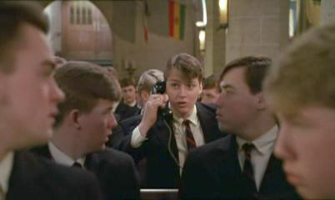
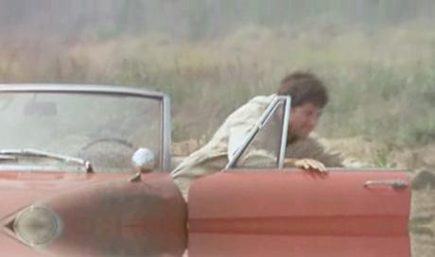
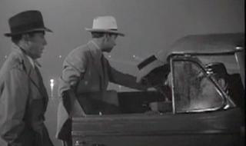
“Talk on phone”
“Get out of car”
Learning realistic human actions from movies, Laptev et al. 2008

Slide 28
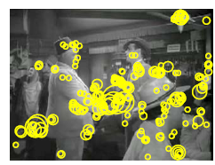
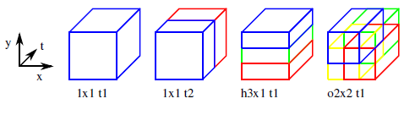
Approach
Space-time interest point detectors
Descriptors
  HOG, HOF
Pyramid histograms (3x3x2)
SVMs with Chi-Squared Kernel
Spatio-Temporal Binning
Interest Points

Slide 29
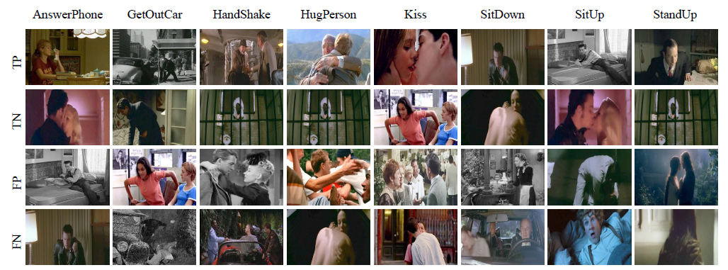
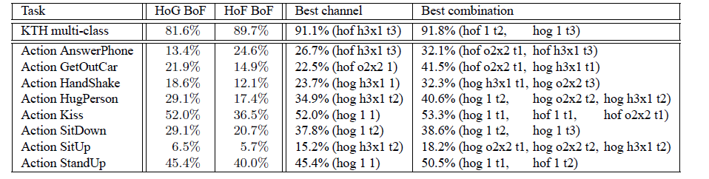
Results

Slide 30
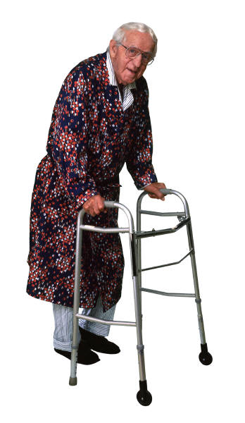
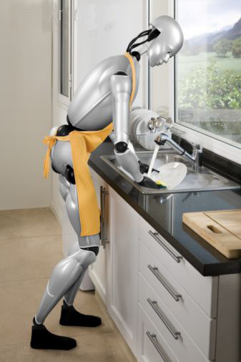
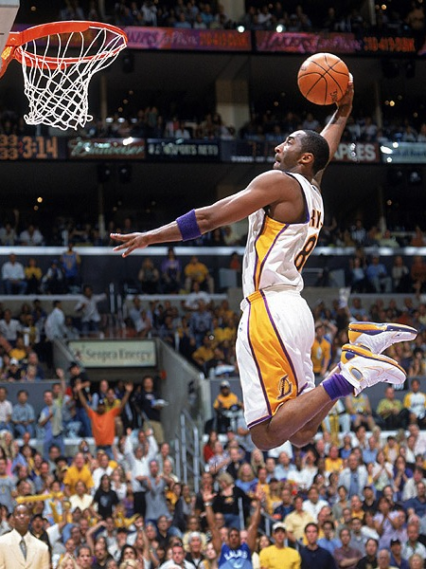
Action Recognition using Pose and Objects
Modeling Mutual Context of Object and Human Pose in Human-Object Interaction Activities, B. Yao and Li Fei-Fei, 2010
Slide Credit: Yao/Fei-Fei

Slide 31
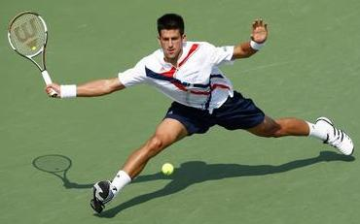
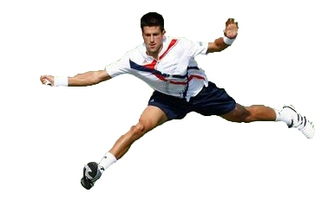
Human-Object Interaction
Holistic image based classification
Integrated reasoning
Human pose estimation
Head
Right-arm
Left-arm
Torso
Right-leg
Left-leg
Slide Credit: Yao/Fei-Fei

Slide 32

Human-Object Interaction
Holistic image based classification
Integrated reasoning
Human pose estimation
Object detection
Tennis racket
Slide Credit: Yao/Fei-Fei

Slide 33
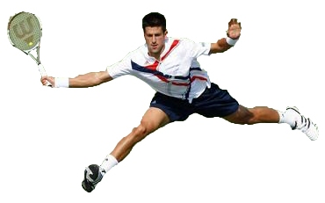
Human-Object Interaction
Holistic image based classification
Integrated reasoning
Human pose estimation
Object detection
Action categorization
Head
Right-arm
Left-arm
Tennis racket
Torso
Right-leg
Left-leg
HOI activity: Tennis Forehand
Slide Credit: Yao/Fei-Fei

Slide 34
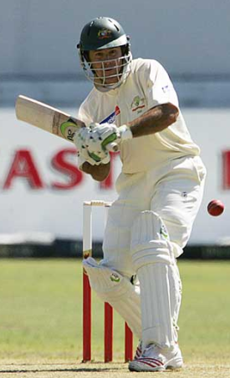
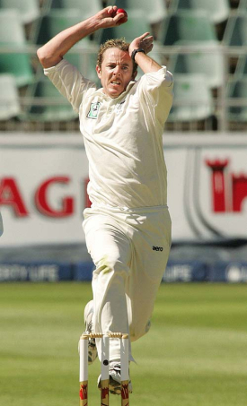
Human pose estimation & Object detection
Human pose estimation is challenging.
Difficult part appearance
Self-occlusion
Image region looks like a body part
Felzenszwalb & Huttenlocher, 2005
Ren et al, 2005
Ramanan, 2006
Ferrari et al, 2008
Yang & Mori, 2008
Andriluka et al, 2009
Eichner & Ferrari, 2009
Slide Credit: Yao/Fei-Fei

Slide 35
Human pose estimation & Object detection
Human pose estimation is challenging.
Felzenszwalb & Huttenlocher, 2005
Ren et al, 2005
Ramanan, 2006
Ferrari et al, 2008
Yang & Mori, 2008
Andriluka et al, 2009
Eichner & Ferrari, 2009
Slide Credit: Yao/Fei-Fei

Slide 36
Human pose estimation & Object detection
Facilitate
Given the object is detected.
Slide Credit: Yao/Fei-Fei

Slide 37
Human pose estimation & Object detection
Object detection is challenging
Small, low-resolution, partially occluded
Image region similar to detection target
Viola & Jones, 2001
Lampert et al, 2008
Divvala et al, 2009
Vedaldi et al, 2009
Slide Credit: Yao/Fei-Fei

Slide 38
Human pose estimation & Object detection
Object detection is challenging
Viola & Jones, 2001
Lampert et al, 2008
Divvala et al, 2009
Vedaldi et al, 2009
Slide Credit: Yao/Fei-Fei

Slide 39
Human pose estimation & Object detection
Facilitate
Given the pose is estimated.
Slide Credit: Yao/Fei-Fei

Slide 40

Human pose estimation & Object detection
Mutual Context
Slide Credit: Yao/Fei-Fei

Slide 41

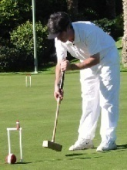






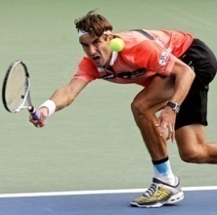
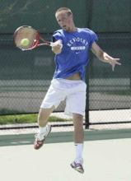
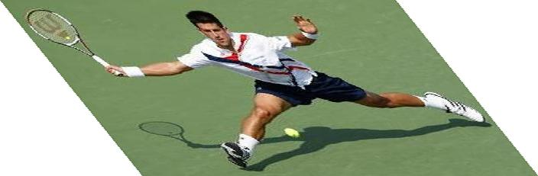

Mutual Context Model Representation
A:
Activity
A
Tennis forehand
Croquet shot
Volleyball smash
Human pose
H
O:
Object
O
Tennis racket
Croquet mallet
Volleyball
Body parts
P₁
P₂
P_{N}
H:
f_{O}
f₁
f₂
f_{N}
Intra-class variations
More than one H for each A;
Unobserved during training.
Image evidence
P:
l_{P}: location; θ_{P}: orientation; s_{P}: scale.
f:
Shape context.
[Belongie et al, 2002]
Slide Credit: Yao/Fei-Fei

Slide 42
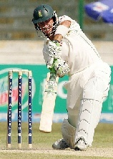
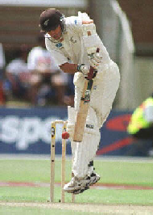
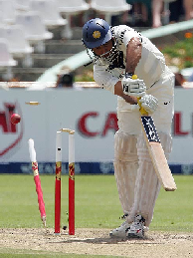
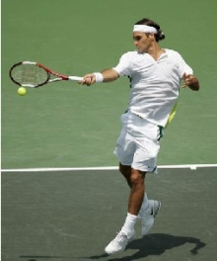

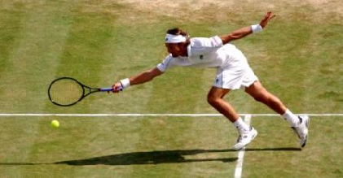
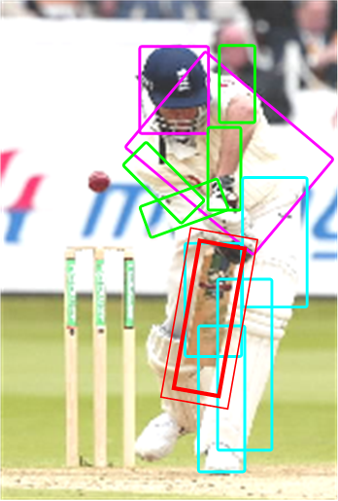
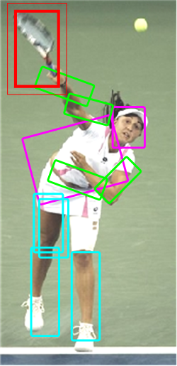


Activity Classification Results
Cricket shot
Tennis forehand
Our model
Gupta et al, 2009
Bag-of-words
SIFT+SVM
Slide Credit: Yao/Fei-Fei

Slide 43

More results
Joint
Independent
Joint
Independent

Slide 44
Take-home messages
Action recognition is an open problem.
  How to define actions?
  How to infer them?
  What are good visual cues?
  How do we incorporate higher level reasoning?

Slide 45
Take-home messages
Some work done, but it is just the beginning of exploring the problem. So far…
  Actions are mainly categorical
  Most approaches are classification using simple features (spatial-temporal histograms of gradients or flow, s-t interest points, SIFT in images)
  Just a couple works on how to incorporate pose and objects
  Not much idea of how to reason about long-term activities or to describe video sequences

Slide 46
What is an action?
Action: a transition from one state to another
Who is the actor?
How is the state of the actor changing?
What (if anything) is being acted on?
How is that thing changing?
What is the purpose of the action (if any)?

Slide 47
Lecture VII
Part II: Interest Seam Image for Near Duplicate Video Retrieval

Slide 48






Problem to solve
S₁={s₁₁,s₁₂,…s_{1n1}} ≈ S₂={s₂₁,s₂₂,…s_{2n2}} ≈ S₃={s₃₁,s₃₂,…s_{3n3}}
≠
≠
≠
S₄={s₄₁,s₄₂,…s_{4n4}} ≈ S₅={s₅₁,s₅₂,…s_{5n5}} ≈ S₆={s₆₁,s₆₂,…s_{6n6}}
Notes:
Define near duplicate in this slides
Articulate what we would like to achieve in this work
What we would like to achieve in this work
Find an efficient visual representation for the video content: 1. compact, 2. invariant. 3. discriminative

Slide 49















Specifications
Efficient
Discriminative
≠
Invariant
=
Billions of online videos
from YouTube, Hulu ……
Notes:
Gigantic amount of visual data, discriminative v.s. invariance

Slide 50
Applications
Near duplicate video retrieval
Copyright infringement protection
Video Ads monitoring
Video information security & forensics
Re-ranking/grouping of video search results
……

Slide 51
Outline
Interest seam image: from video to image
Local feature & min-hash: from image to signature
Large scale video retrieval:
  Sorted inverted list leveraging temporal context
  Scene verification with GIST
Experimental results: dataset, evaluation, etc..

Slide 52




Interest seam image
T

Slide 53


Interest seam
Definition of a seam (vertical):
Interest seam

Slide 54


Saliency map
α
+
1-α
=

Slide 55


Saliency map

Slide 56
Find the interest seam
Solution space: ≈ O(w×h×3^{h-1})
Dynamic program: O(w×h)
E(p,k)
3 10 7 2 2
4 3 7 0 4
5 7 2 6 5
9 7 1 9 10
4 5 10 7 2
E_{m}(p,k)
( 3, --) (10,--) (7, --) (2, --) (2, --)
(14, 1) (13, 1) (17, 1) (7, 2) (6, 3)
(19, 0) (24, 2) (19, 2) (23, 2) (12, 3)
(33, 1) (31, 1) (25, 1) (32, 3) (33, 3)
(37, 0) (38, 0) (42, 3) (40, 4) (35, 4)
E_{m}(0, i)= E(0,i)
E_{m}(1, 2)= 7 + max{ 10, 7, 2} = 17
E_{m}(2, 4)= 5 + max{7, 6} = 12
… … …
[Avidan & Shamir, SIGGRAPH’07]

Slide 57


Naïve slice vs interest seam
Seam
Interest seam image
Slice
Slice image
[Nog, et al, TMM’02]

Slide 58




Key-frame based representation
Key-frame based representation
  Beginning/middle of the video shot
  Frame with extreme motion intensity
Problem: shot boundary detection is difficult
Different shot boundary style
Different shot position
Different content
Different views
[Kim&Hwang, TCSVT’02]

Slide 59


Key-frame v.s. interest seam image
Key-frame
Interest seam Image
“gradual change” shot boundary
“hard” shot boundary
Different shot boundary style
Notes:
A small temporal misalignment may result in totally different keyframes. (Titanic.a & Titanic.c) ()

Slide 60



Key-frame v.s. interest seam image
Key-frame
Interest seam Image
Different Shot Boundary Position
Notes:
406 ➔ 461 a.15, c.11

Slide 61




Seam under editing
Resizing
Notes:
Each image into single slide
Say: to test the repeatability, synthesis the manipulated video data, then compare the seam generated from both the original and the manipulated….

Slide 62



Seam under editing
Aspect ratio

Slide 63




Seam under editing
Contrast change

Slide 64




Seam under editing
Gamma correction

Slide 65
Outline
Interest seam image: from video to image
Local feature & min-hash: from image to signature
Large scale video retrieval:
  Sorted inverted list leveraging temporal context
  Scene verification with GIST
Experimental results: dataset, evaluation, etc..

Slide 66

Local feature extraction
[ 12, 0, 7, …, 3, 128]
[ 7, 6, 17, …, 167, 4]
[ 29, 76, 10, …, 35, 55]
……
[ 210, 34, 22, …, 68, 11]
Interest seam image
MSER
[Matas et al, 2002]
SIFT
[Lowe, 2002]
Bag of features

Slide 67

Bag-of-features to bag-of-visual-words
[ 12, 0, 7, …, 3, 128]
[ 7, 6, 17, …, 167, 4]
22
[ 29, 76, 10, …, 35, 55]
1187
……
…
[ 210, 34, 22, …, 68, 11]
52
566
{22, 52, 1187, …, 566}
Pre-trained CodeBook by K-means

Slide 68
Similarity measure
D₁ ={22, 52, 1187, …, 566}
D₂ = {37, 45, 52, 68, 1187, …, 775}
Problem: the number of visual words for each video could be thousands (~1000)

Slide 69
Min-hash
Algorithm: generate Min-hash signature for a set
  Generate a random permutation of the vocabulary
  Pick the lowest ranked word appeared in the set
Vocabulary = {1, 2, 3, 4, 5, 6, 7}
D₁ = {2, 4, 6, 7}
D₂ = {1, 4, 5, 7}
Permutation 1:{2, 4, 3, 1, 7, 6, 5}
mh₁(D₁) = {2}
mh₁(D₂) = {4}
Permutation 2:{7, 4, 1, 3, 6, 2, 5}
mh₂(D₁) = {7}
mh₂(D₂) = {7}
mh(D₁) = {2, 7}
mh(D₂) = {1,7}
[Broder, Sequences’1997]

Slide 70
Min-hash
Property: Pr[mh_{k}(D₁) =mh_{k}(D₂)]=Sim(D₁,D₂)
Sim(mh(D₁), mh(D₂)) ≈ Sim(D₁, D₂)
D₁ = {2, 4, 6, 7}
D₂ = {1, 4, 5, 7}
mh(D₁) = {2, 7}
mh(D₂) = {4, 7}
[Broder, Sequences’1997]

Slide 71
Video signature
Interest Seam
MSER
SIFT
[ 12, 0, 7, …, 3, 128]
{1187, 566 …, 22}
{22, 52, 1187, …, 566}
[ 7, 6, 17, …, 167, 4]
[ 29, 76, 10, …, 35, 55]
60 integers
>1000 integers
……
[ 210, 34, 22, …, 68, 11]
Min-hash signature
Bag-of-visual-words
Bag-of-features

Slide 72
Outline
Interest seam image: from video to image
Local feature & min-hash: from image to signature
Large scale video retrieval:
  Sorted inverted list leveraging temporal context
  Scene verification with GIST
Experimental results: dataset, evaluation, etc..

Slide 73
Inverted file indexing
3
4
6
7
1
Each list is still very
long with large database, O(m) complexity.
2
3
4
… …
6
7
8
9

Slide 74




Temporal context
Temporal position t_{i} of local feature
=
≠

Slide 75
Redefinition of similarity
Recall the similarity between two signatures
Leverage temporal context

Slide 76
Sorted inverted list
1
3
4
6
7
2
Visit each list now is with complexity O(log(m))
3
4
… …
… t1≤t2 ≤t3 ≤t4…
6
7
8
9

Slide 77
Scene verification with GIST
Strong global characteristics
GIST features [Oliva & Torralba, IJCV2001]
G=[ 6, 17, 28, …, 135, 201]
128 dimensions

Slide 78
Scene verification with GIST
Cosine similarity for GIST
Combined similarity for ranking

Slide 79
Outline
Interest seam image: from video to image
Local feature & min-hash: from image to signature
Large scale video retrieval:
  Sorted inverted list leveraging temporal context
  Scene verification with GIST
Experiments
  Dataset, evaluation, etc..

Slide 80
Dataset
10382 videos crawled from the web
  TV show, drama, MTV, movie trailers, etc..
1 sets of unlabeled video clips
  D: 246551 unlabeled video shots
2 sets of labeled video clips
  Qt: 150 videos each undergone 9 controlled transformations
  Qr: manually labeled near duplicate videos, (~800)

Slide 81


Slide 82
Experimental settings and criterion
Leave-one-out strategy
  For each query q from either Qr or Qt, the rest of Qr or Qt are mixed with D to form the database against which q is querying.
Mean Average Precision
q : r1 x x r2 x x r3 x x x x
AP(q) = ( 1/1 + 2/4 + 3/7)/3=0.6429
Notes:
Rj: rank of the jth relevant video
Nq: total number of relevant videos to query q

Slide 83
Retrieval accuracy on Qt
Representation | mAP
 | MSER + SIFT | GIST
Interest Seam Image | 0.9699 | 0.9766
Key-frame | 0.894 | 0.9062
Performance comparison between interest seam image and key-frame on local feature(MSER) and global feature(GIST). The evaluation is carried on transformed queries(Qt).

Slide 84
Retrieval accuracy on Qr
Methods | mAP | GIST | SIFT
Interest Seam Image + Scene Verification | 0.9401 | Yes | Yes
Interest Seam Image | 0.8960 | No | Yes
Key-frame + Min-Hash [2] | 0.8179 | No | Yes
Key-frame + GIST [3] | 0.8472 | Yes | No
Temporal Slice [12] | 0.8388 | Yes | No
Hierarchical Framework [18] | 0.8828 | Yes | Yes
Performance comparison between proposed algorithms and state-of-the-art methods on Qr. The last two columns indicate whether each method uses global/local feature. And “Interest Seam Image” means the proposed retrieval system without scene verification.
[2] Chum et al, CIVR’2007 [12] Nog et al, TMM’2002
[3] Douze et al, CIVR’2009 [18] Wu et al, SIGMM’2009

Slide 85

Impact of number of min-hash keys
The test is performed with Qr
Notes:
This is tested on Qr

Slide 86

Impact of Gaussian central prior

Slide 87

Impact of scene verification

Slide 88
Efficiency comparison
Approaches | mAP | Memory | Speed
Min-Hash | 0.8886 | 720 Bytes | 4.09s
Min-Hash + Temporal Context | 0.9165 | 1080 Bytes | 0.47s
Min-Hash + Temporal Context + Scene Verification | 0.9401 | 480 Bytes | 0.24s

Slide 89
Conclusion
Our contributions
  Interest seam image: an efficient video content synopsis
  An efficient, discriminative and invariant video signature
  An video retrieval system leveraging temporal context
Future work
  Explore other applications of interest seam image.
  Further improve the robustness of the interest seam

